Slide 1




ADMIN
Version 3.0

Slide 2
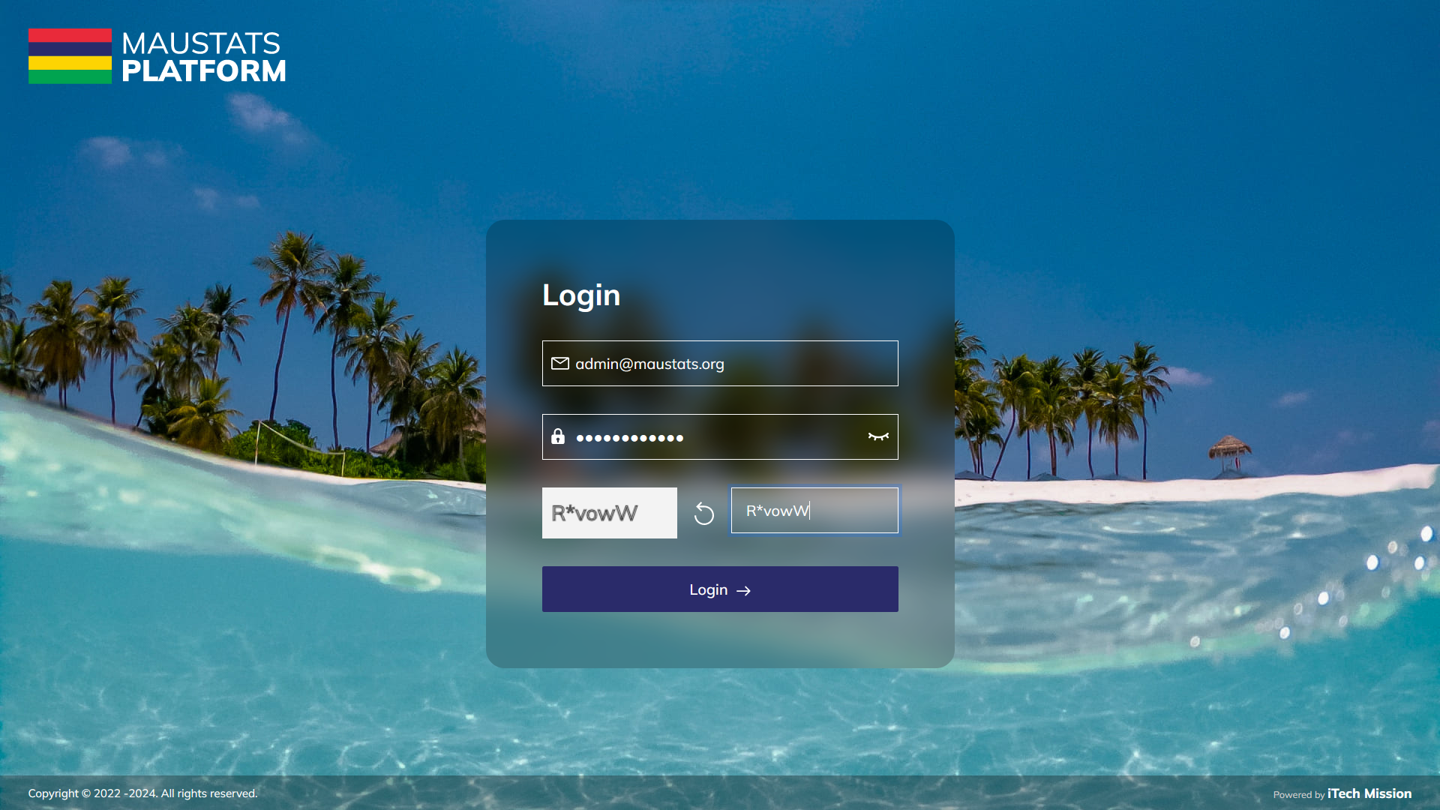
LOGIN
Login using valid credentials to access the admin modules.

Slide 3
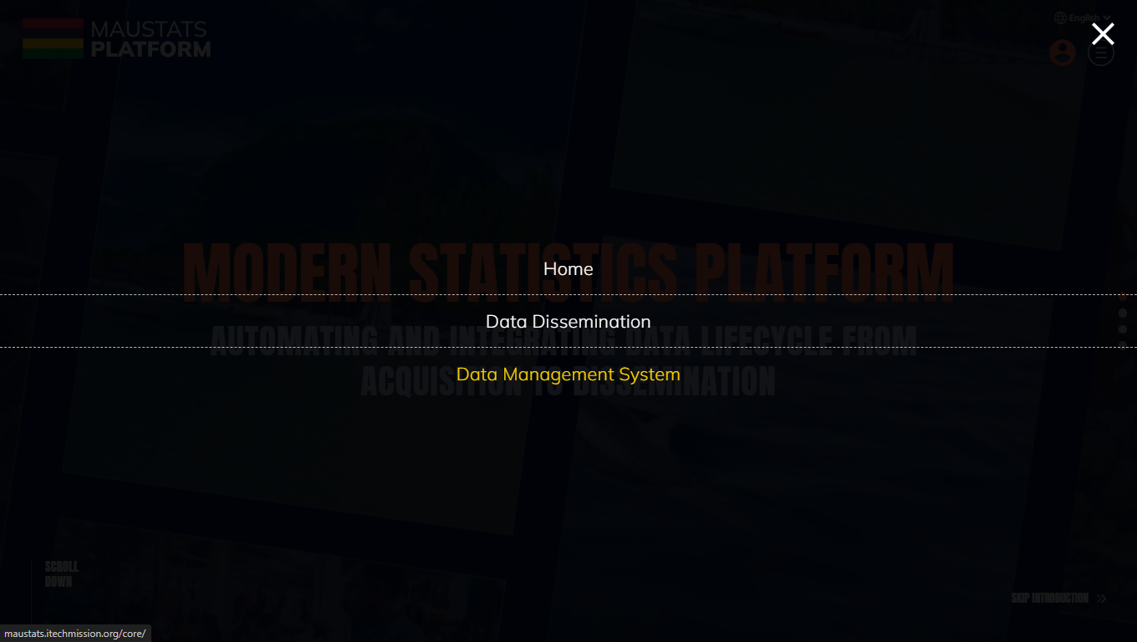
ADMIN
To access Admin, click on burger menu and select Data Management System.

Slide 4

1
CLASSIFICATION

Slide 5
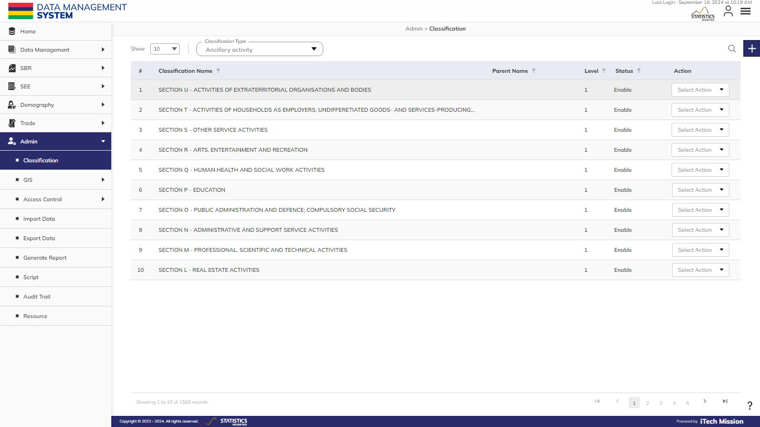
CLASSIFICATION
To manage the Classification Master List, select Admin – Classification.

Slide 6

CLASSIFICATION
Select the Classification Type from the dropdown menu.

Slide 7

CLASSIFICATION
Click on the Plus button and add a new classification.

Slide 8
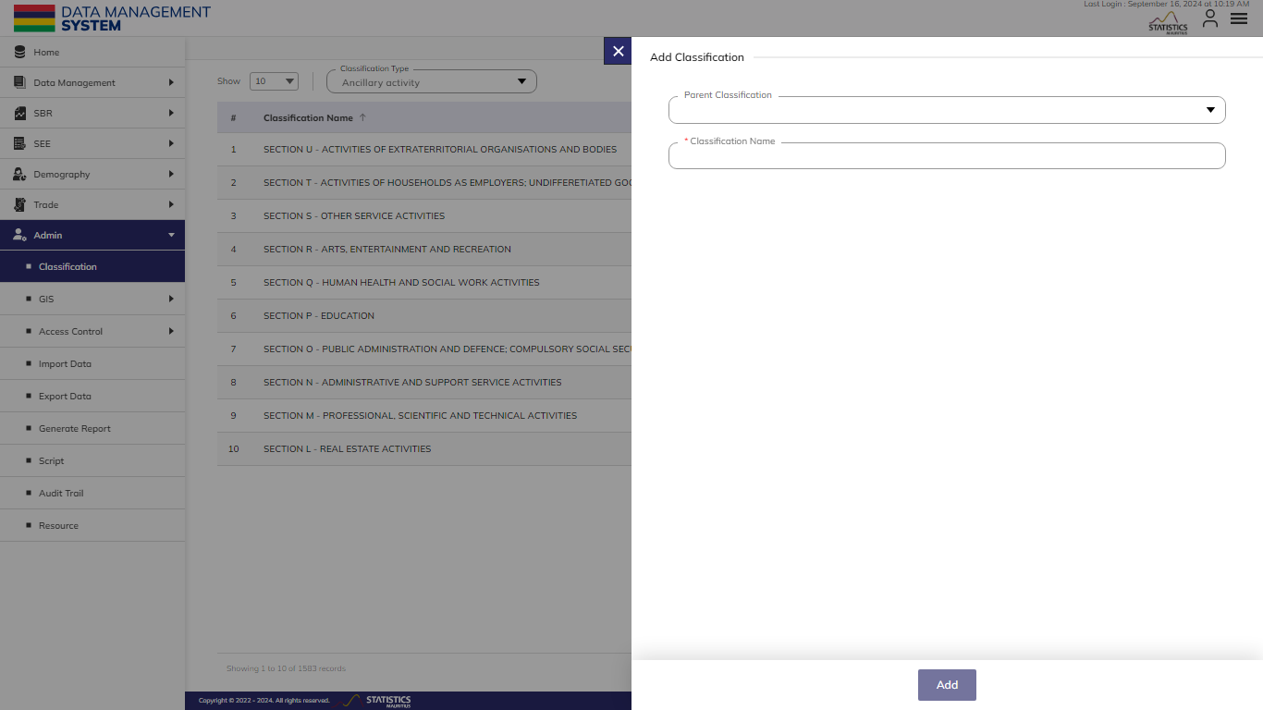
CLASSIFICATION
Select Parent Classification and Enter Classification Name (Mandatory fields to be filled).

Slide 9
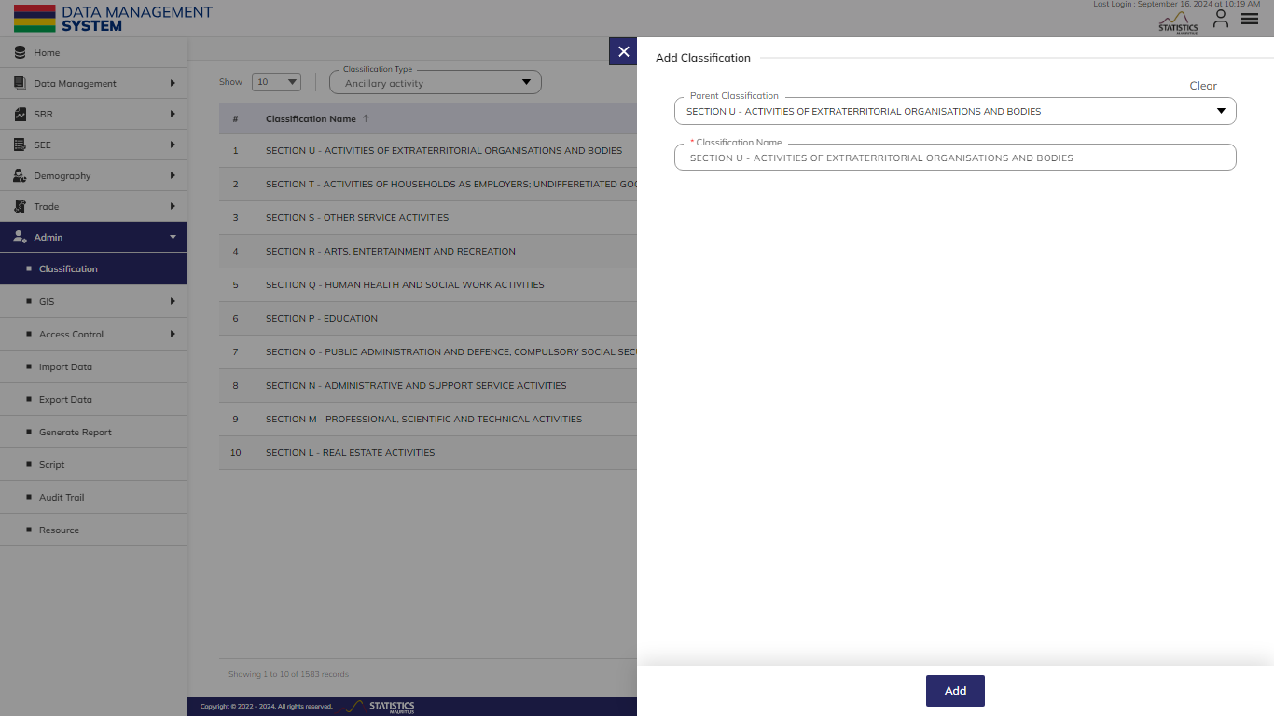
CLASSIFICATION
Click on the Add button to Save the classification.

Slide 10
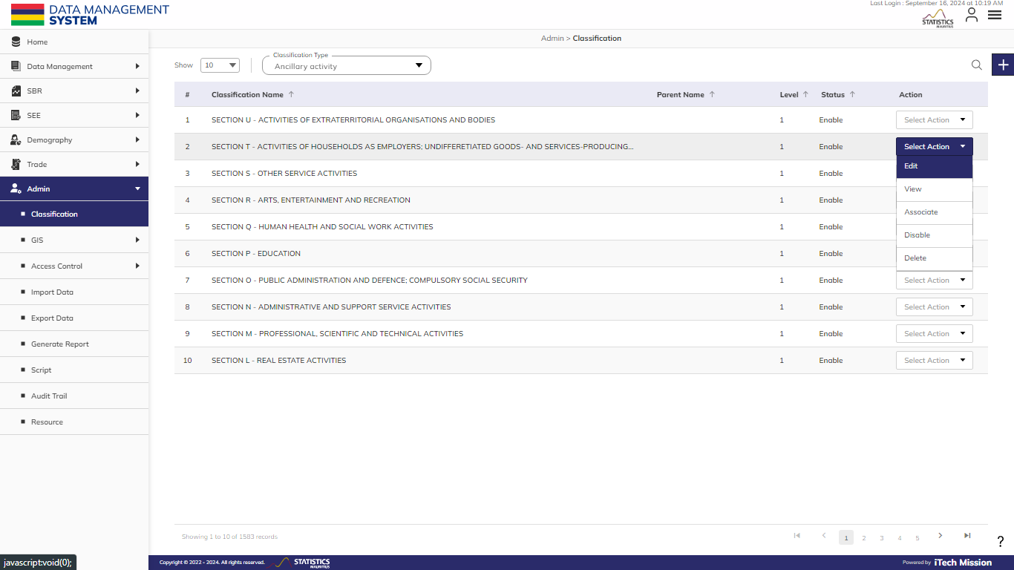
CLASSIFICATION
Click on the action dropdown to Edit, View, Associate, Enable/Disable, and Delete selected classification.

Slide 11
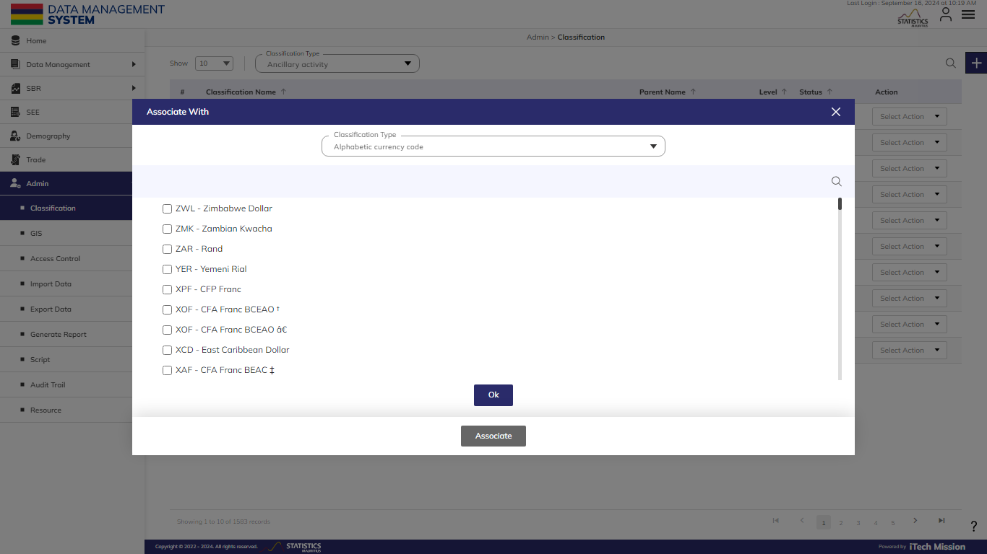
CLASSIFICATION
Click on Associate to associate the data of any existing classification. Select the Classification Type and check the data to be included.

Slide 12
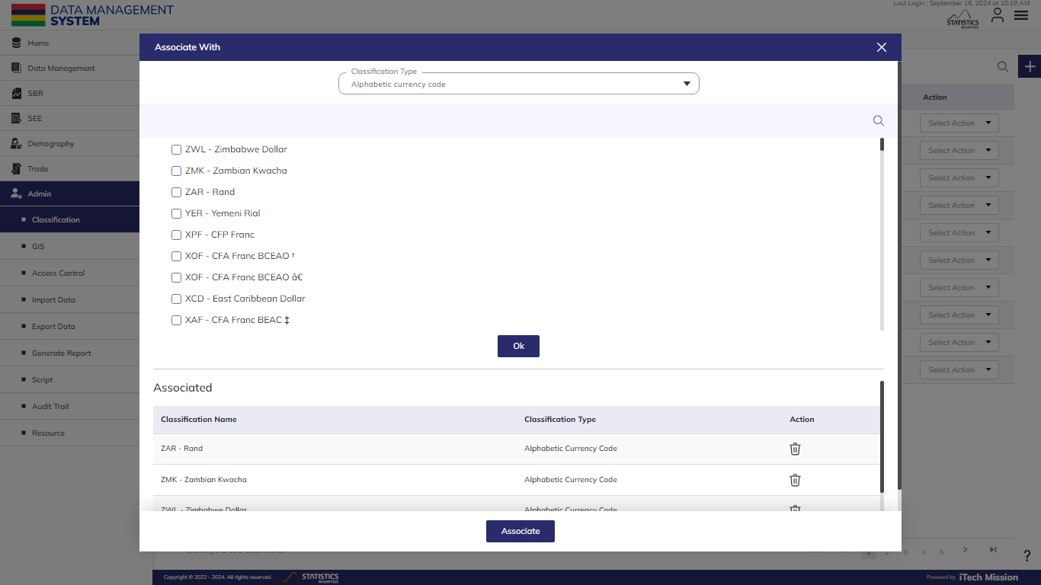
CLASSIFICATION
Click OK to Add the list and then Associate.

Slide 13
2
GIS

Slide 14

ADMIN – GIS
Area
GIS Maps

Slide 15
A
AREA

Slide 16
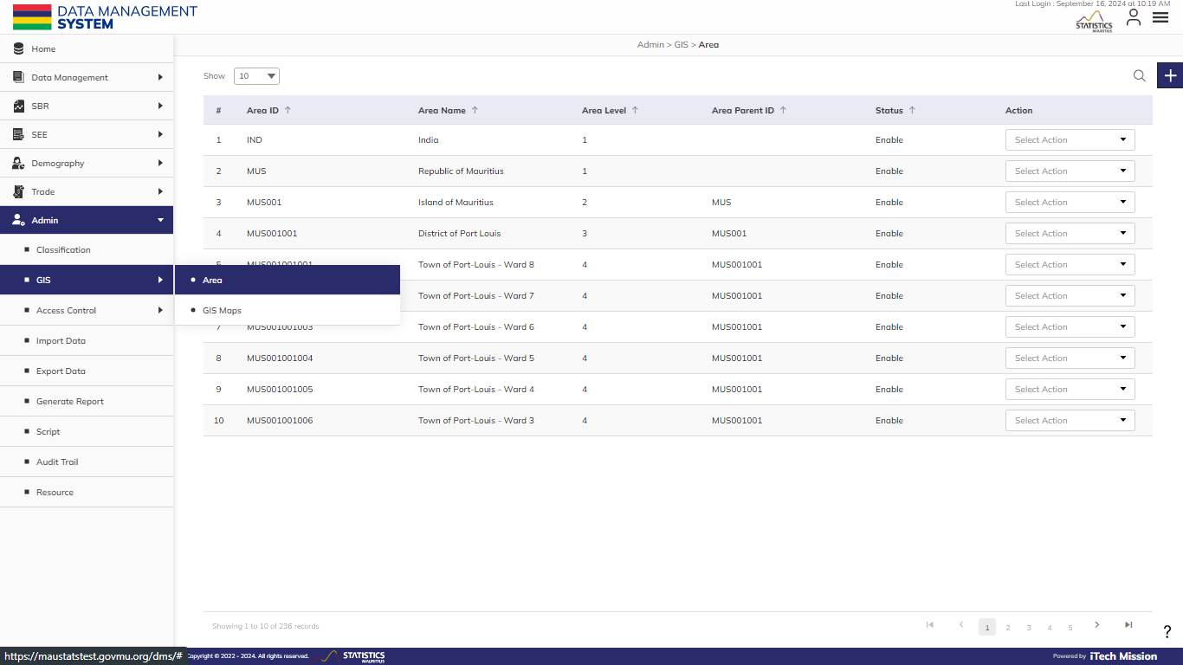
AREA
To manage the Area Master List, select Admin – GIS – Area.

Slide 17
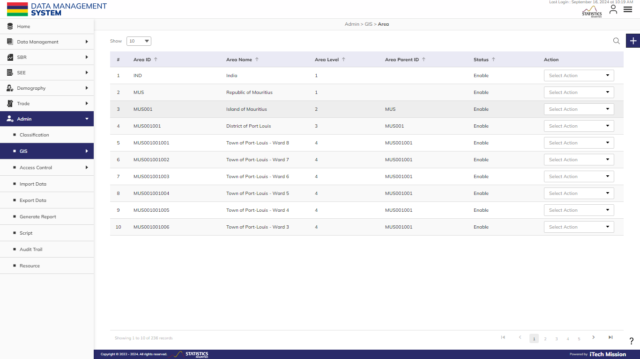
AREA
Click on Plus button and add a new area.

Slide 18
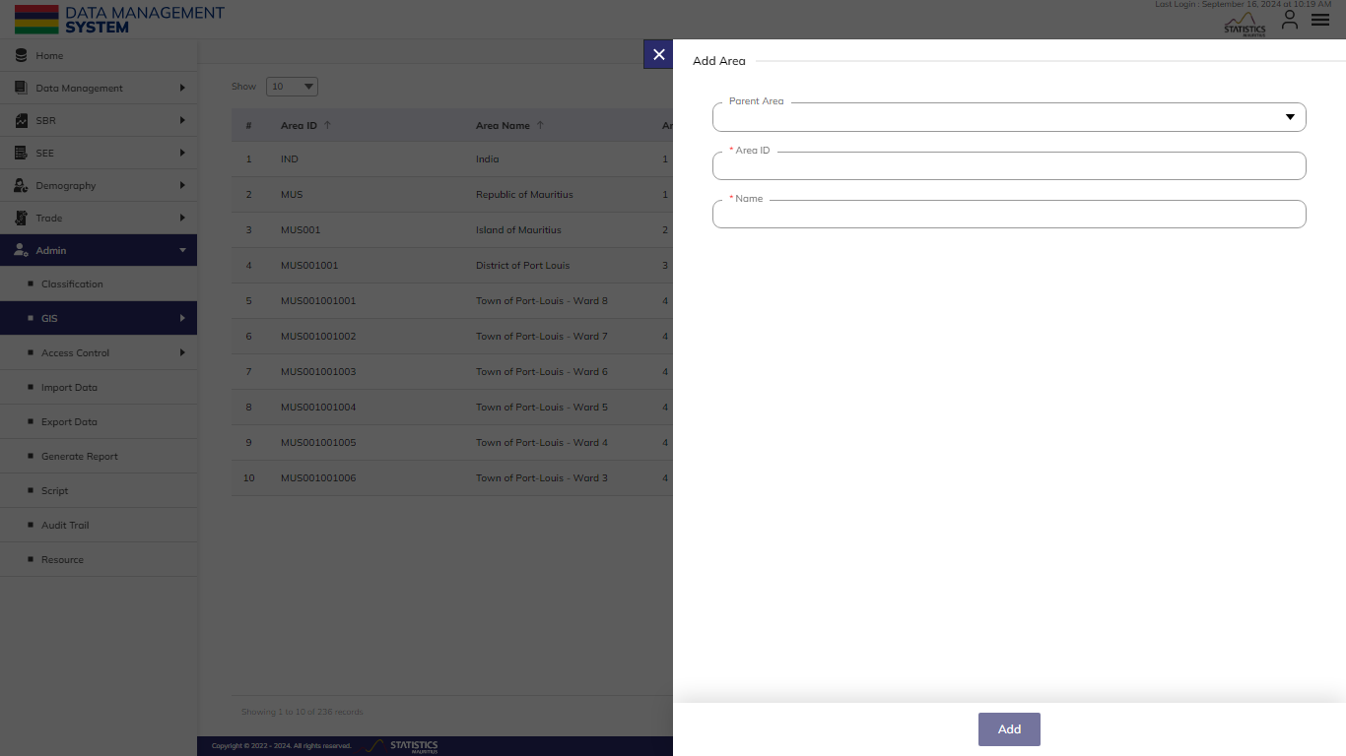
AREA
Select Parent Area, Enter Area ID and Name (Mandatory fields to be filled).

Slide 19
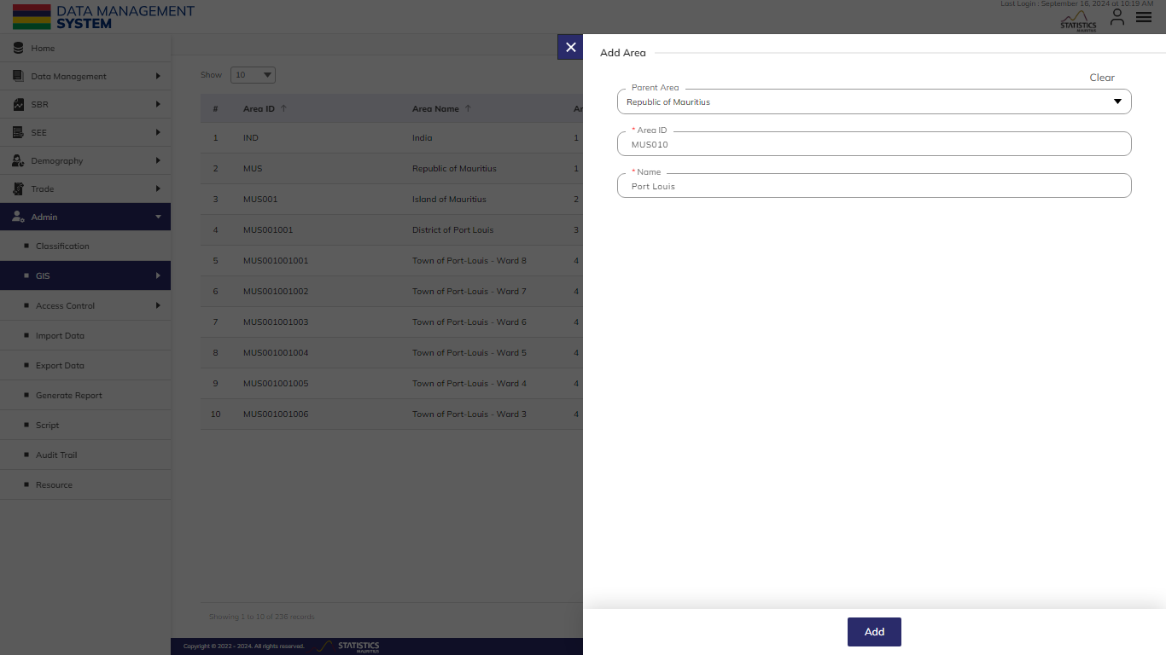
AREA
Click on Add button to save the area.

Slide 20
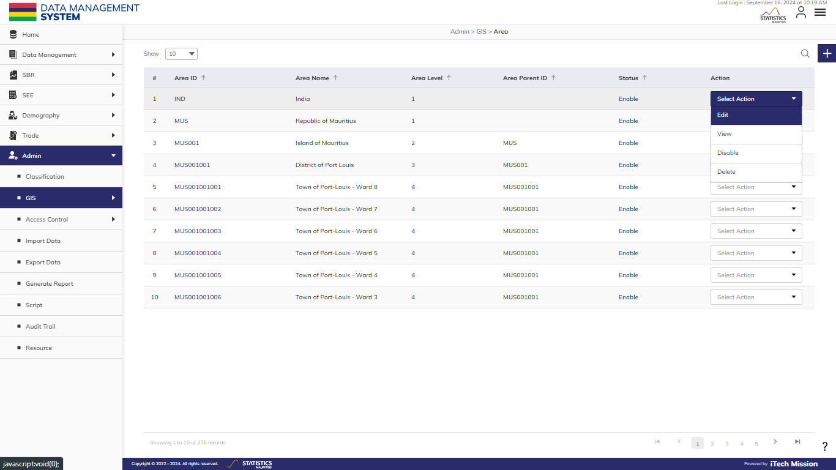
AREA
Click on the action dropdown to Edit, View, Enable/Disable, and Delete selected Area.

Slide 21
B
GIS Maps

Slide 22
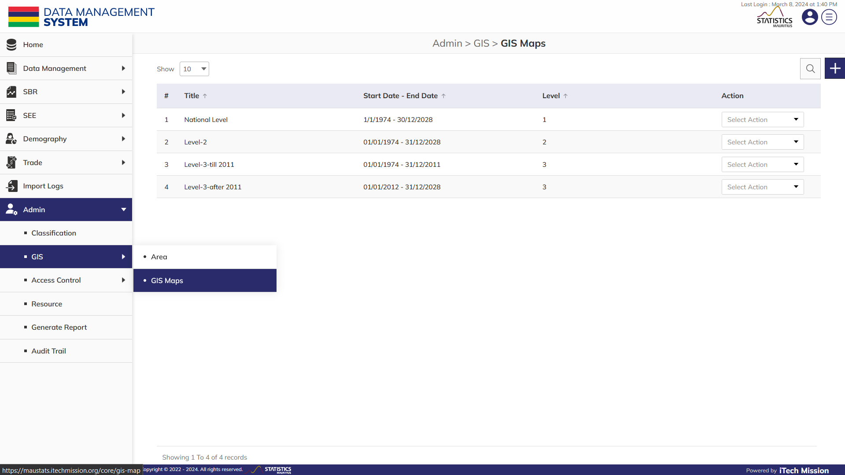
GIS MAPS
To associate/disassociate the maps with the geographical areas. You can associate multiple maps to the same area, Select admin – GIS – area.

Slide 23
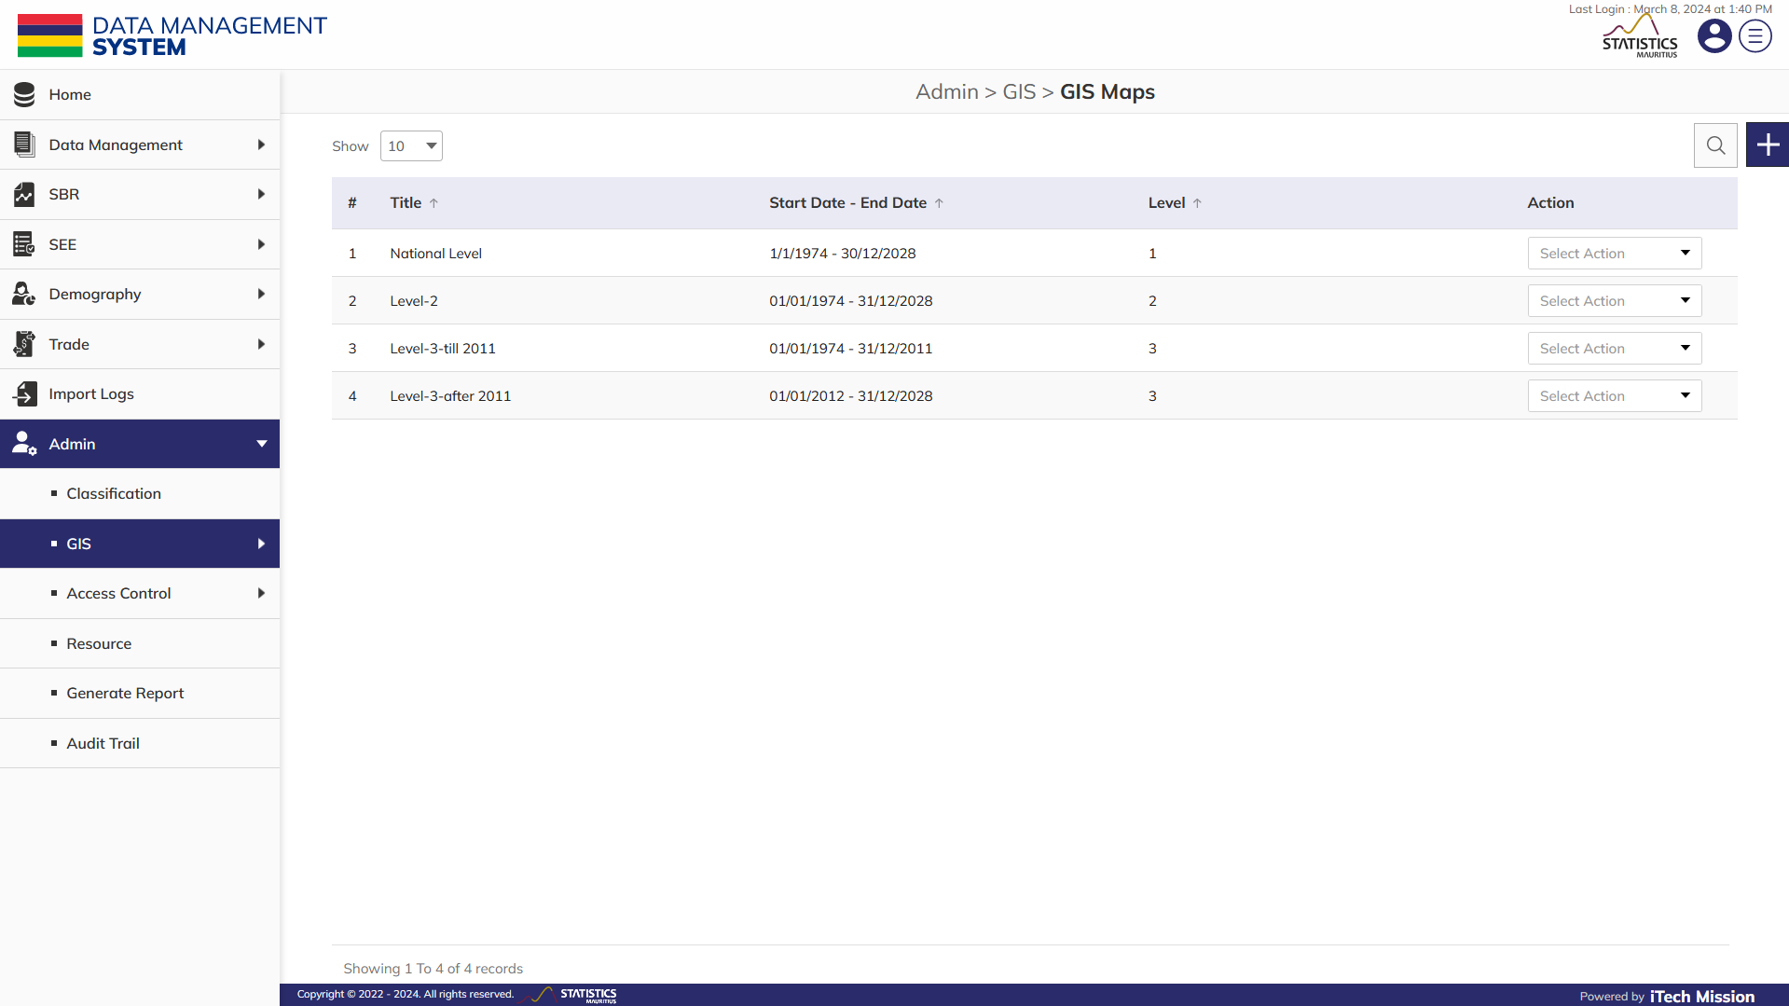
GIS MAPS
Click on Plus button and add a new element.

Slide 24
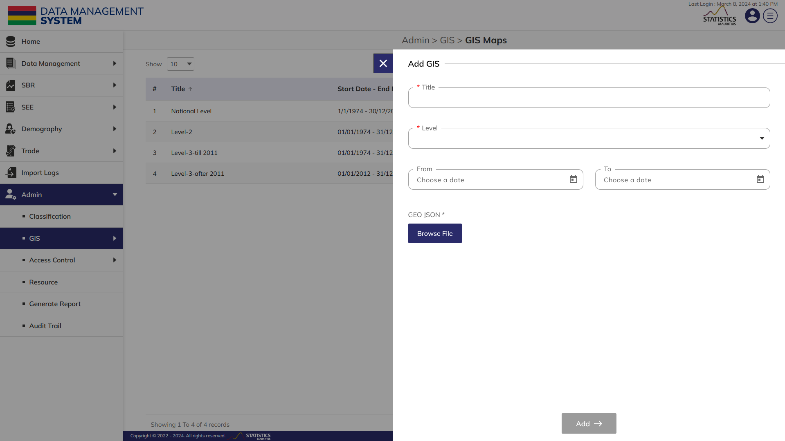
GIS MAPS
Enter Title, select Level, Start Date – End Date, and Browse file to upload the GEO JSON file (Mandatory fields to be filled).

Slide 25
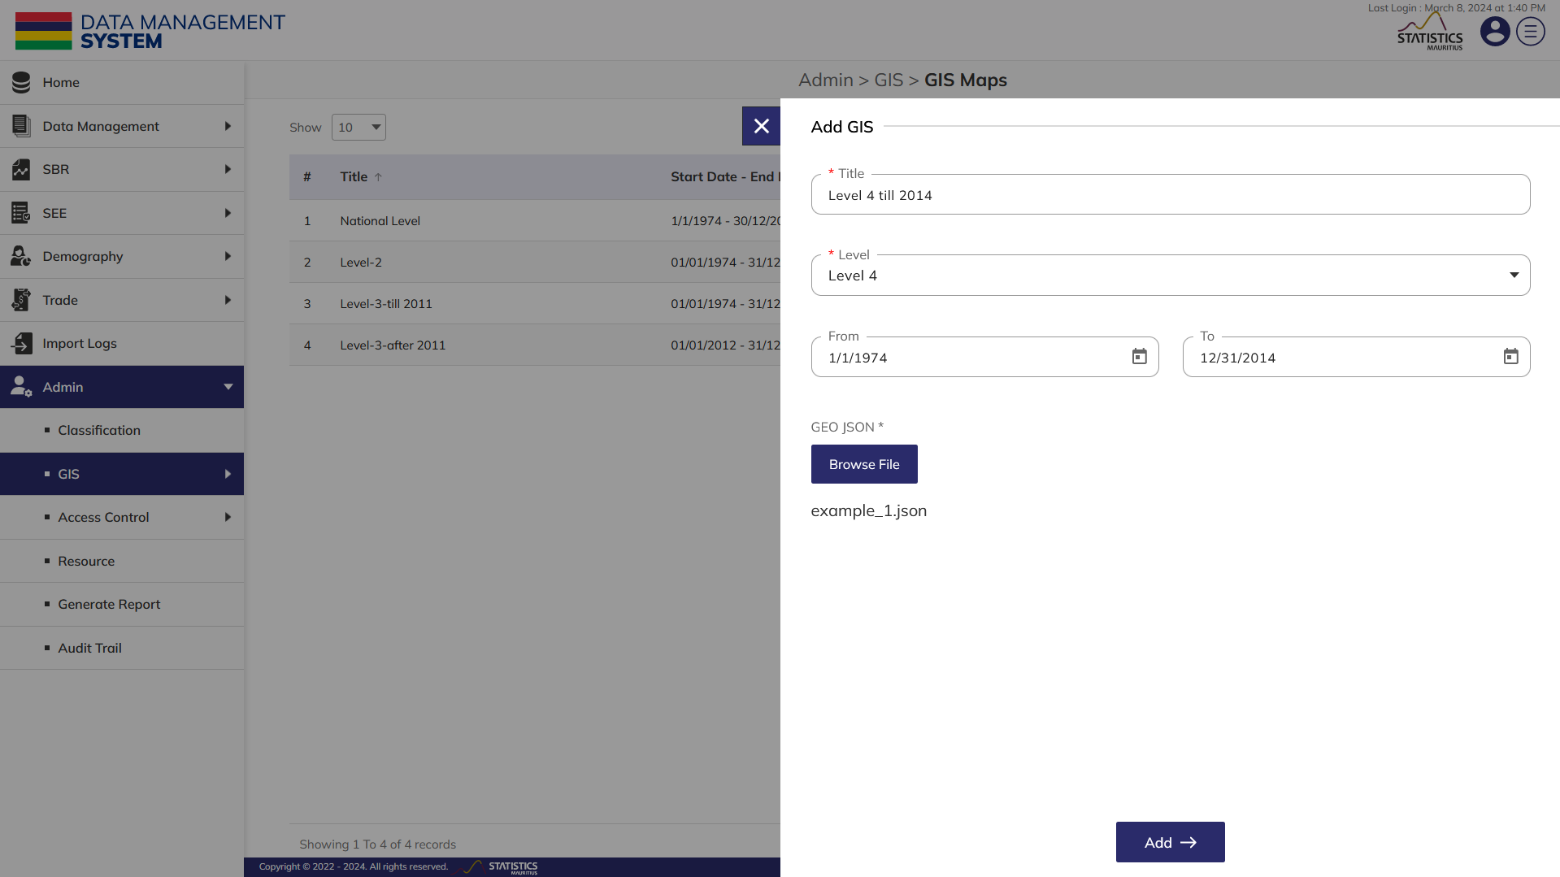
GIS MAPS
Click on Add button to save the element.

Slide 26
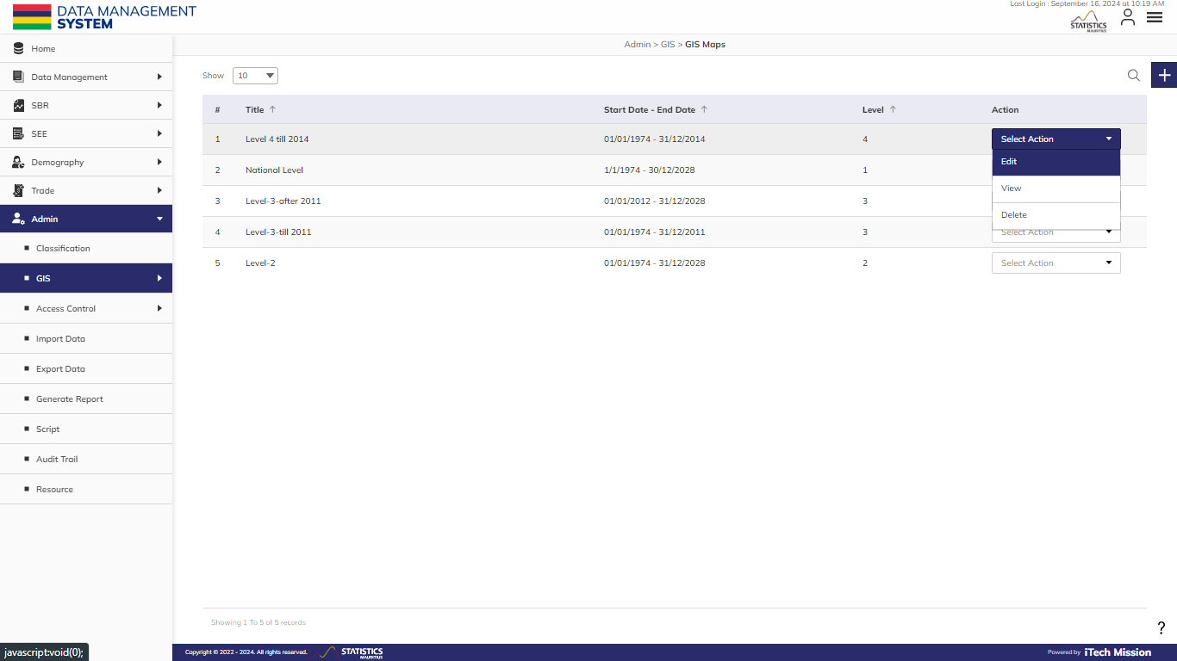
GIS MAPS
Click on the action dropdown to Edit, View, and Delete the selected element.

Slide 27
3
ACCESS CONTROL

Slide 28
ADMIN – ACCESS CONTROL
SM Unit
Role and Permission
User

Slide 29
A
SM
UNIT

Slide 30
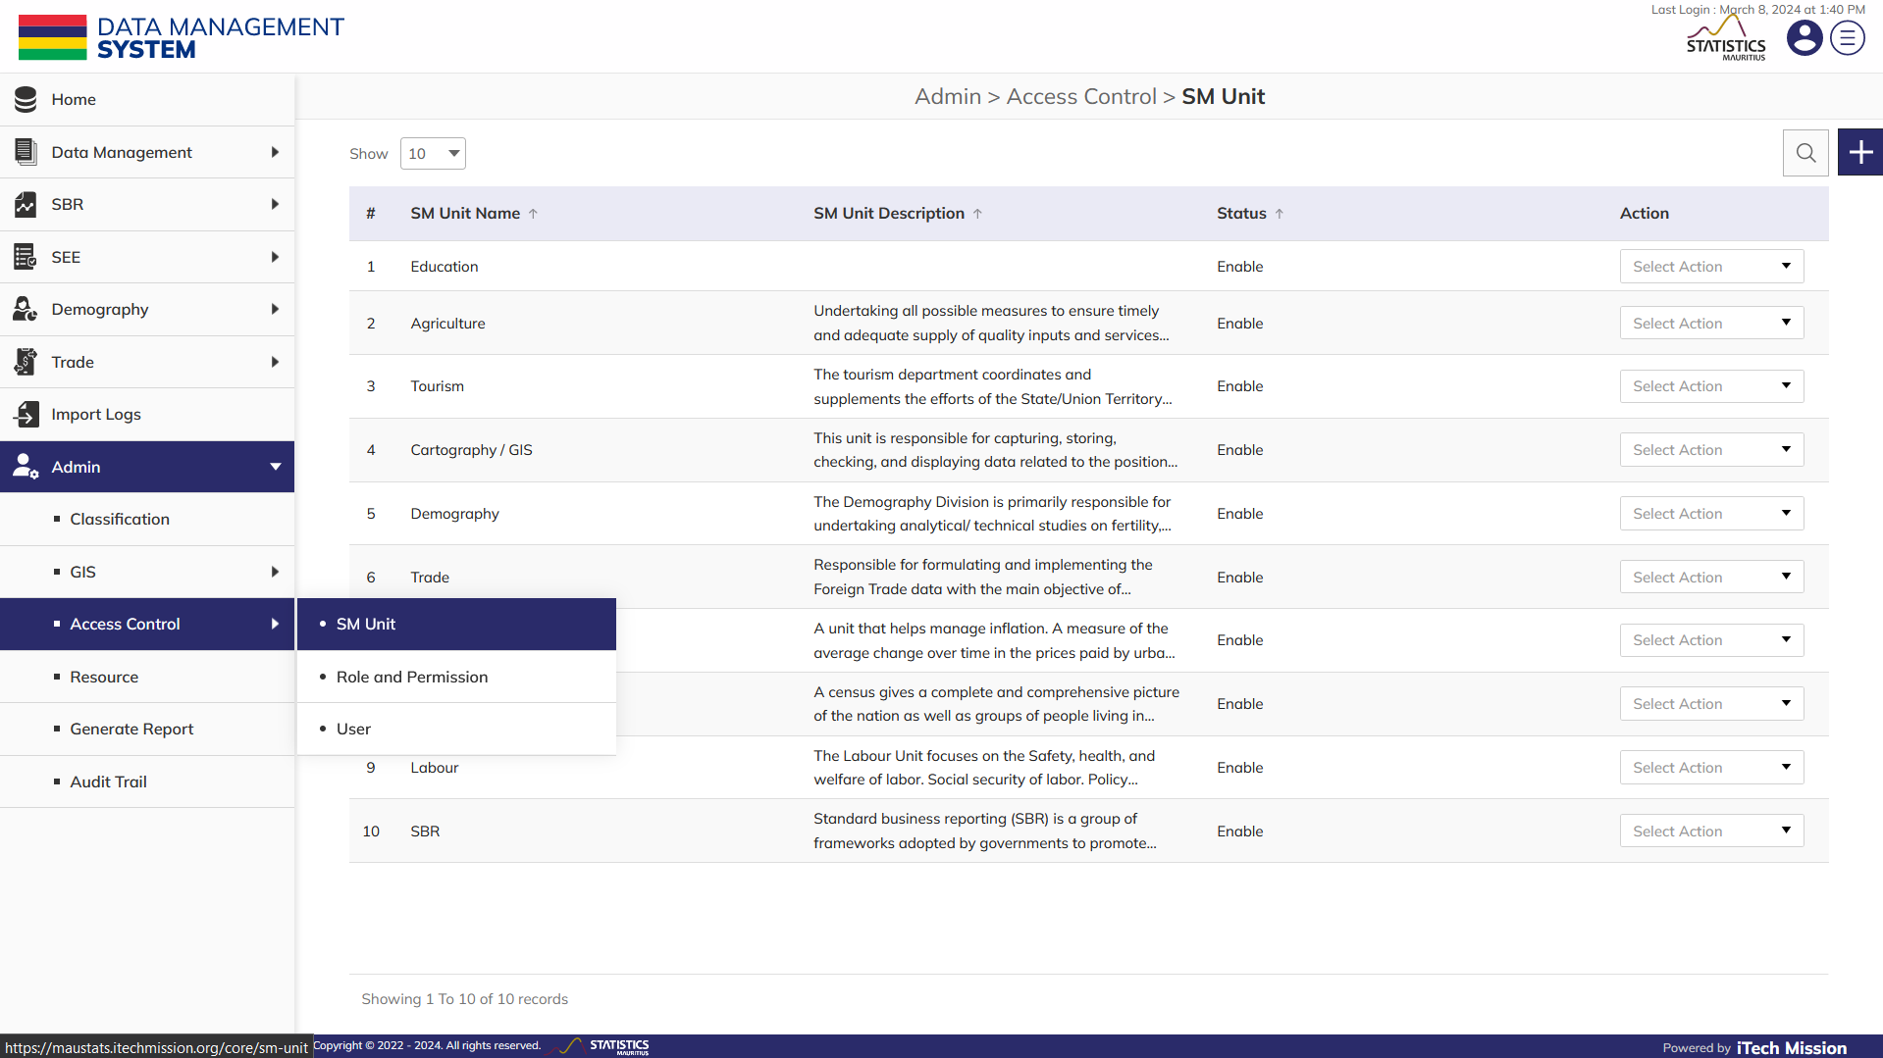
SM UNIT
To manage SM Unit, select Admin – Access Control – SM Unit.

Slide 31
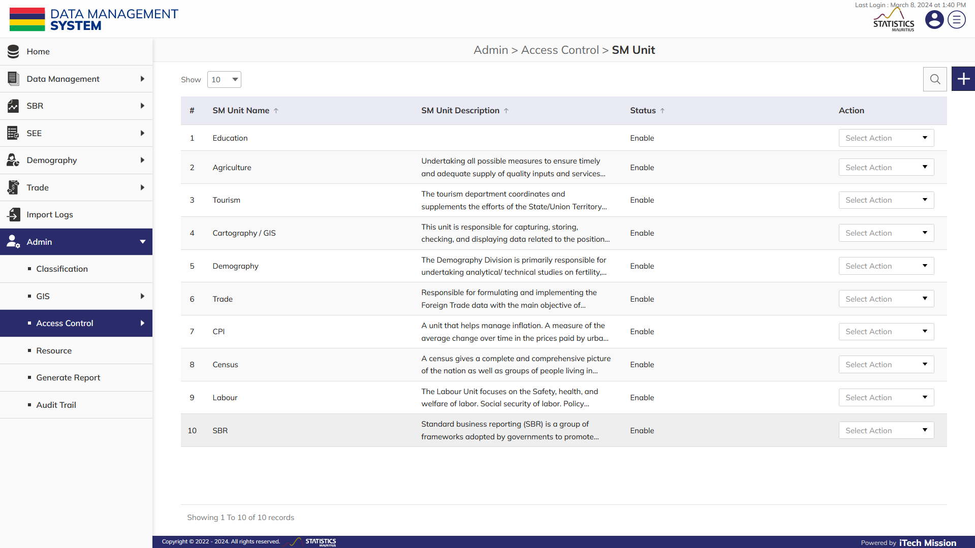
SM UNIT
Click on the Plus button to add a new SM Unit.

Slide 32
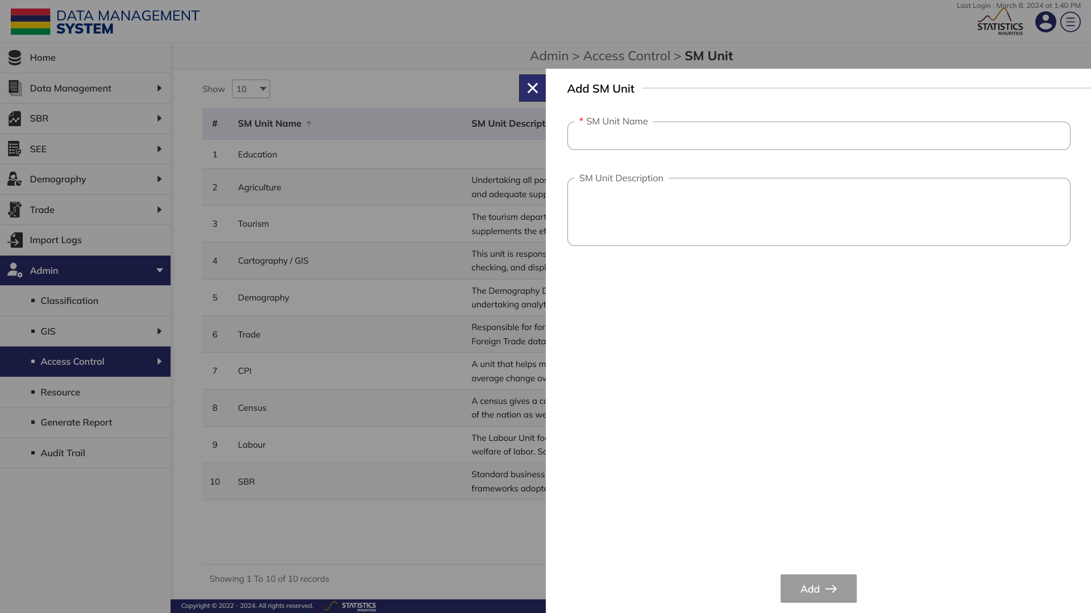
SM UNIT
Enter the SM Unit Name and SM Unit description (Mandatory fields to be filled).

Slide 33
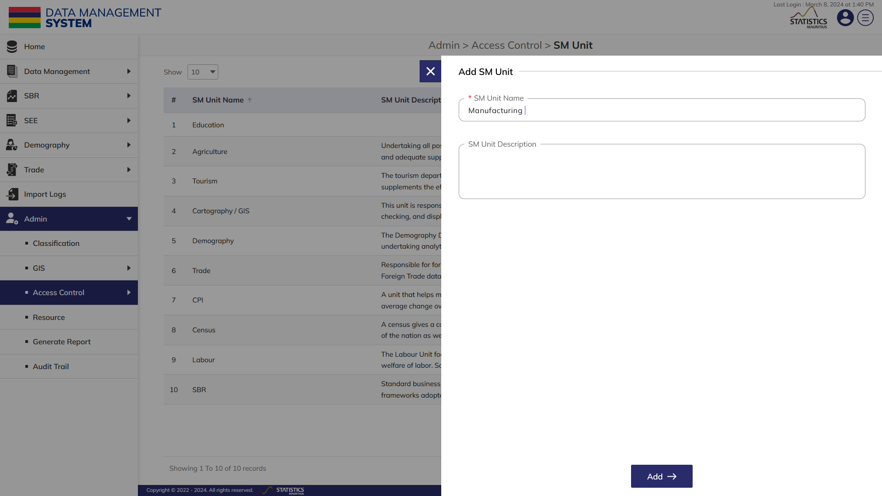
SM UNIT
Click on the Add button to save SM Unit.

Slide 34
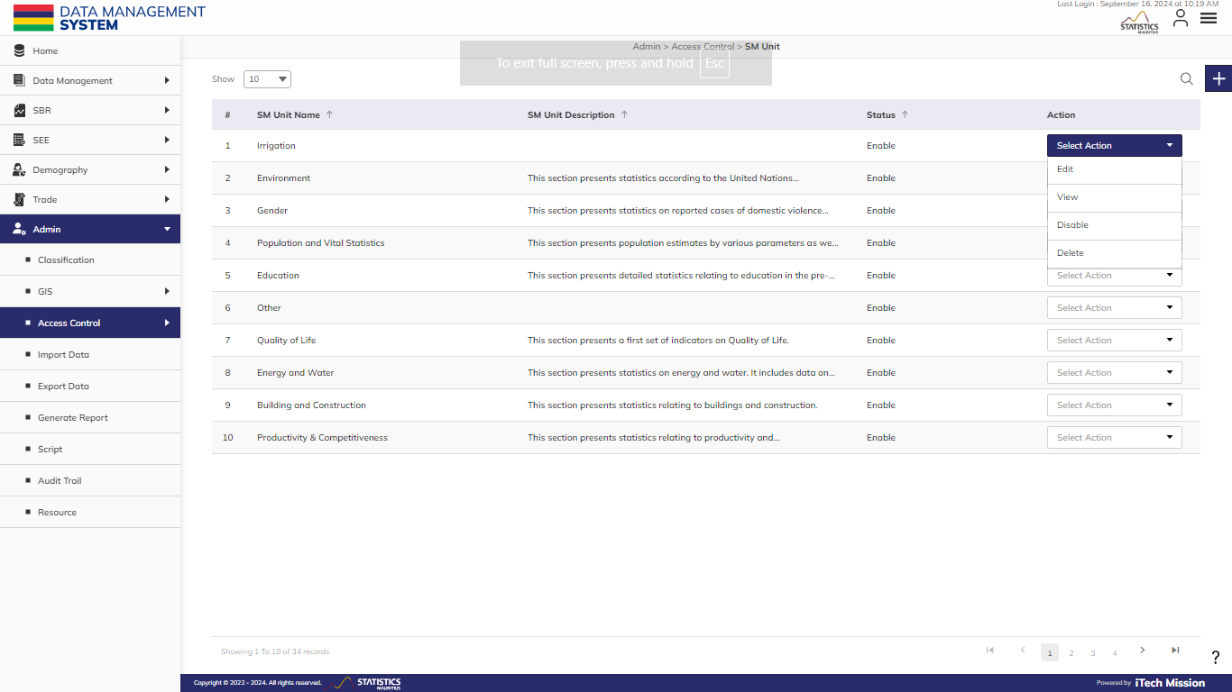
SM UNIT
Click on the action dropdown to Edit, View, Enable/Disable, and Delete selected SM Unit.

Slide 35
B
ROLE AND PERMISSION

Slide 36
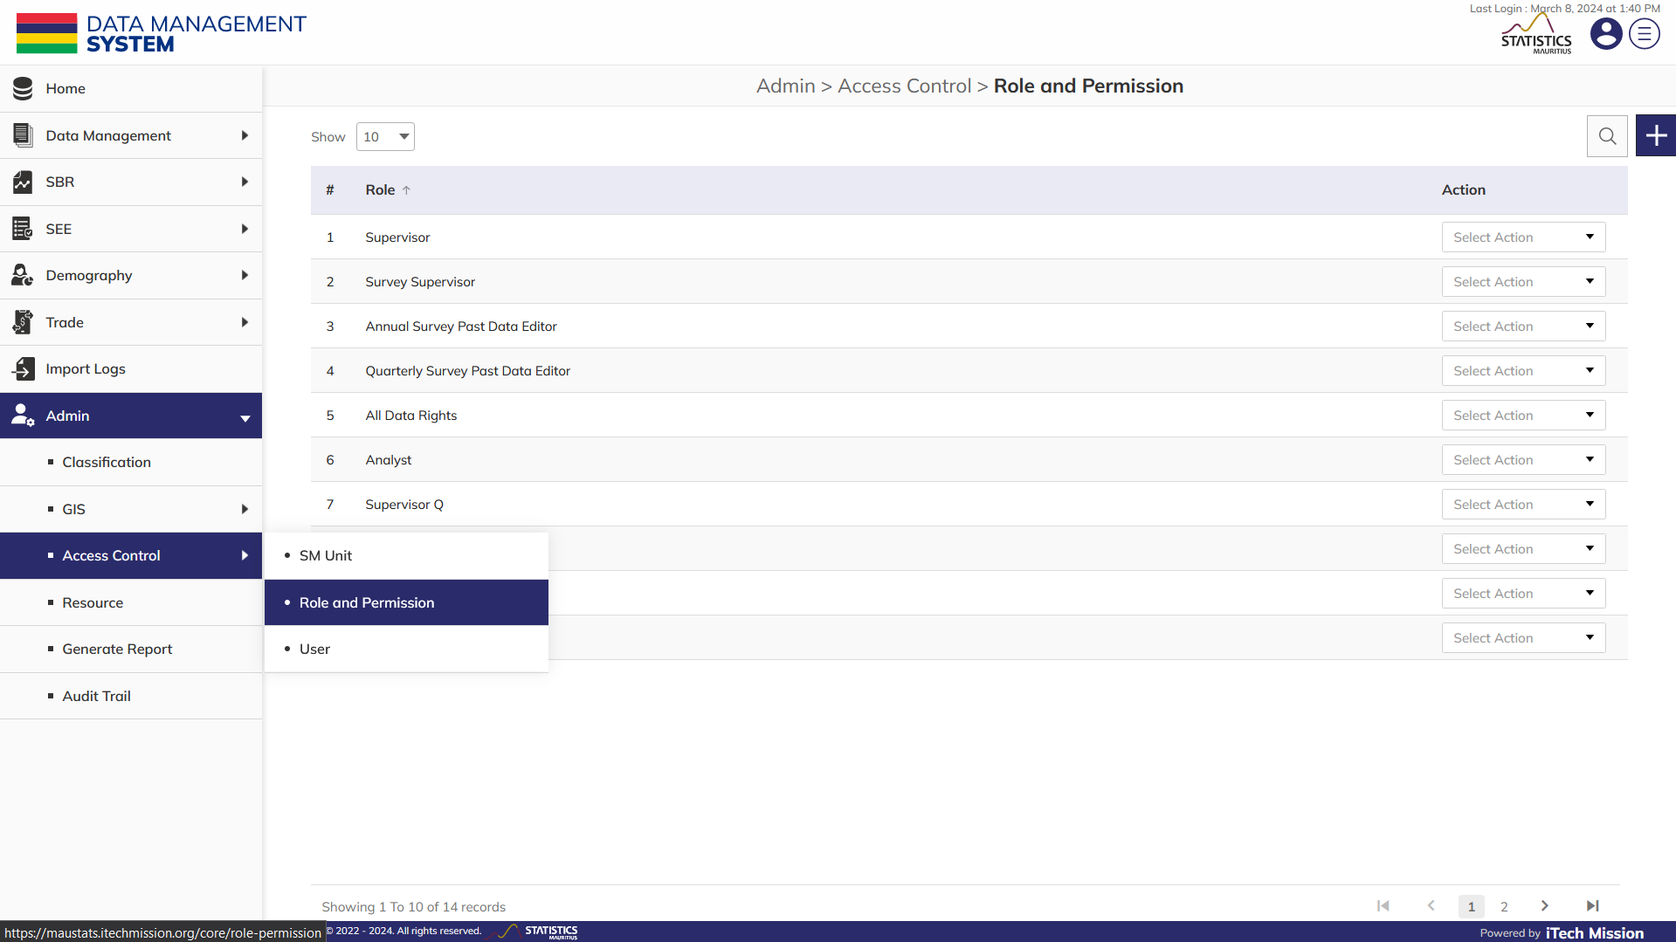
ROLE AND PERMISSION
To create Roles and manage Permissions, select Admin – Access Control – Role and Permission.

Slide 37
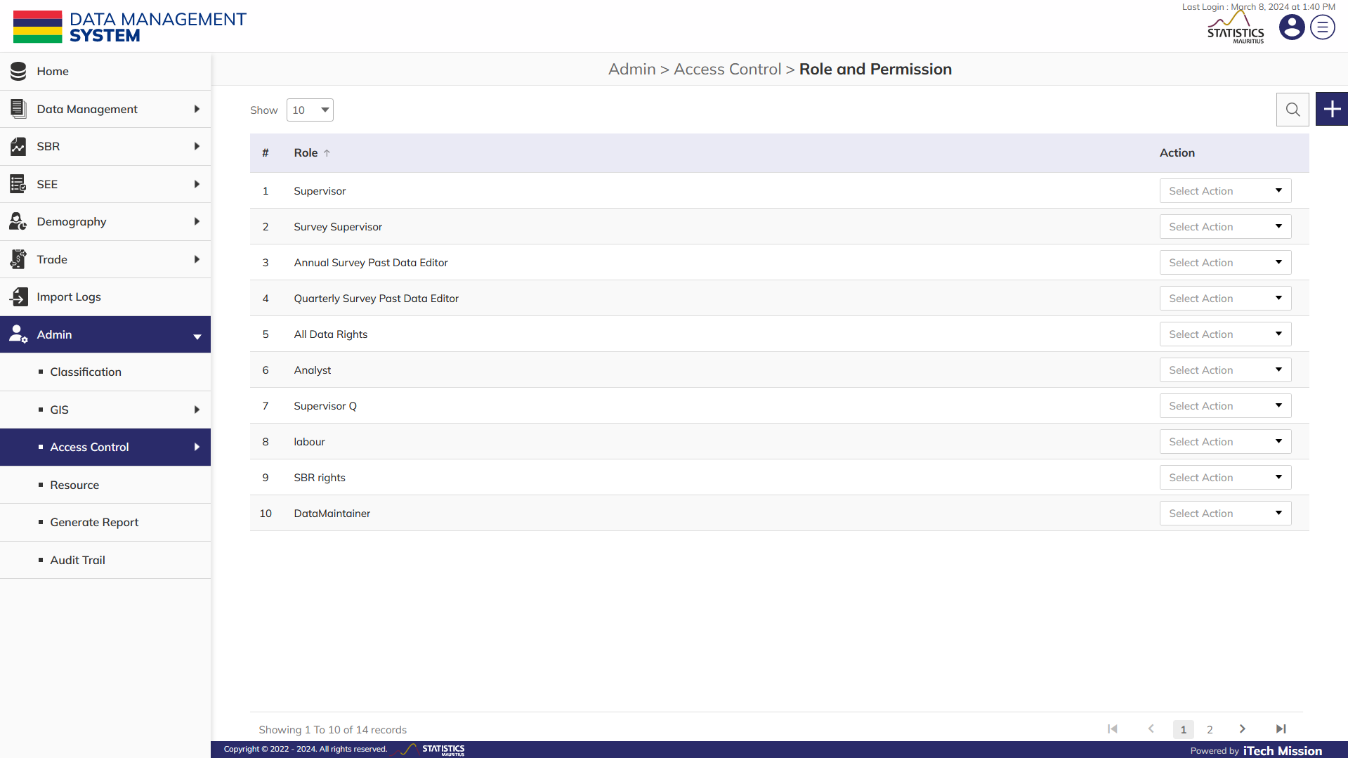
ROLE AND PERMISSION
Click on Plus button to add new role with permission.

Slide 38
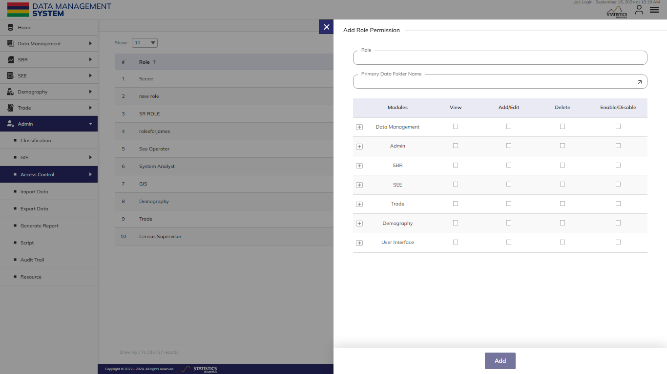
ROLE AND PERMISSION
Enter Role, select Primary Data Folder Name, and Role Permission(s) (Mandatory fields to be filled).

Slide 39
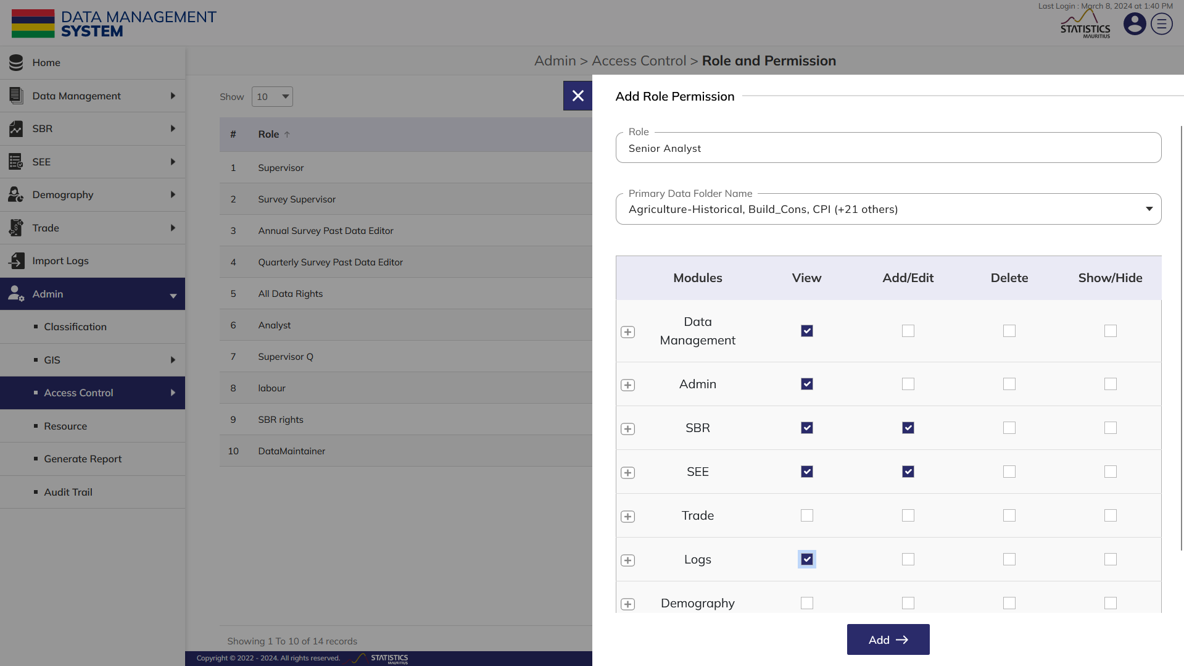
ROLE AND PERMISSION
Click on the Add button to save the role with permissions.

Slide 40
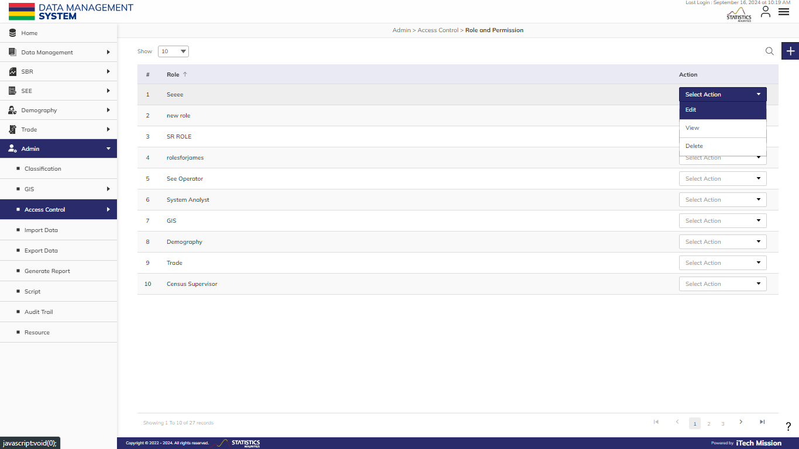
ROLE AND PERMISSION
Click on the action dropdown to Edit, View, and Delete the selected role.

Slide 41
C
USER

Slide 42
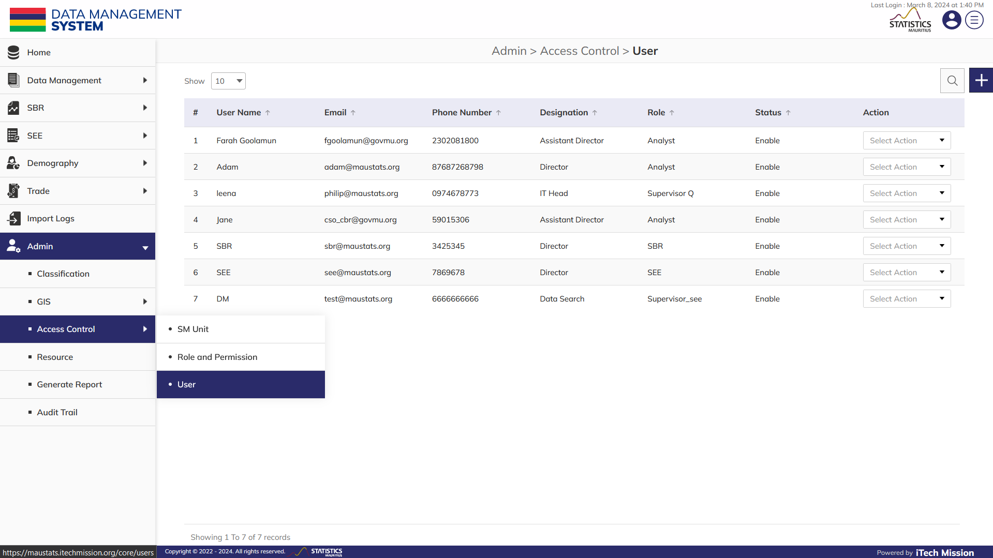
USER
To manage Users, select Admin – Access Control – User.

Slide 43
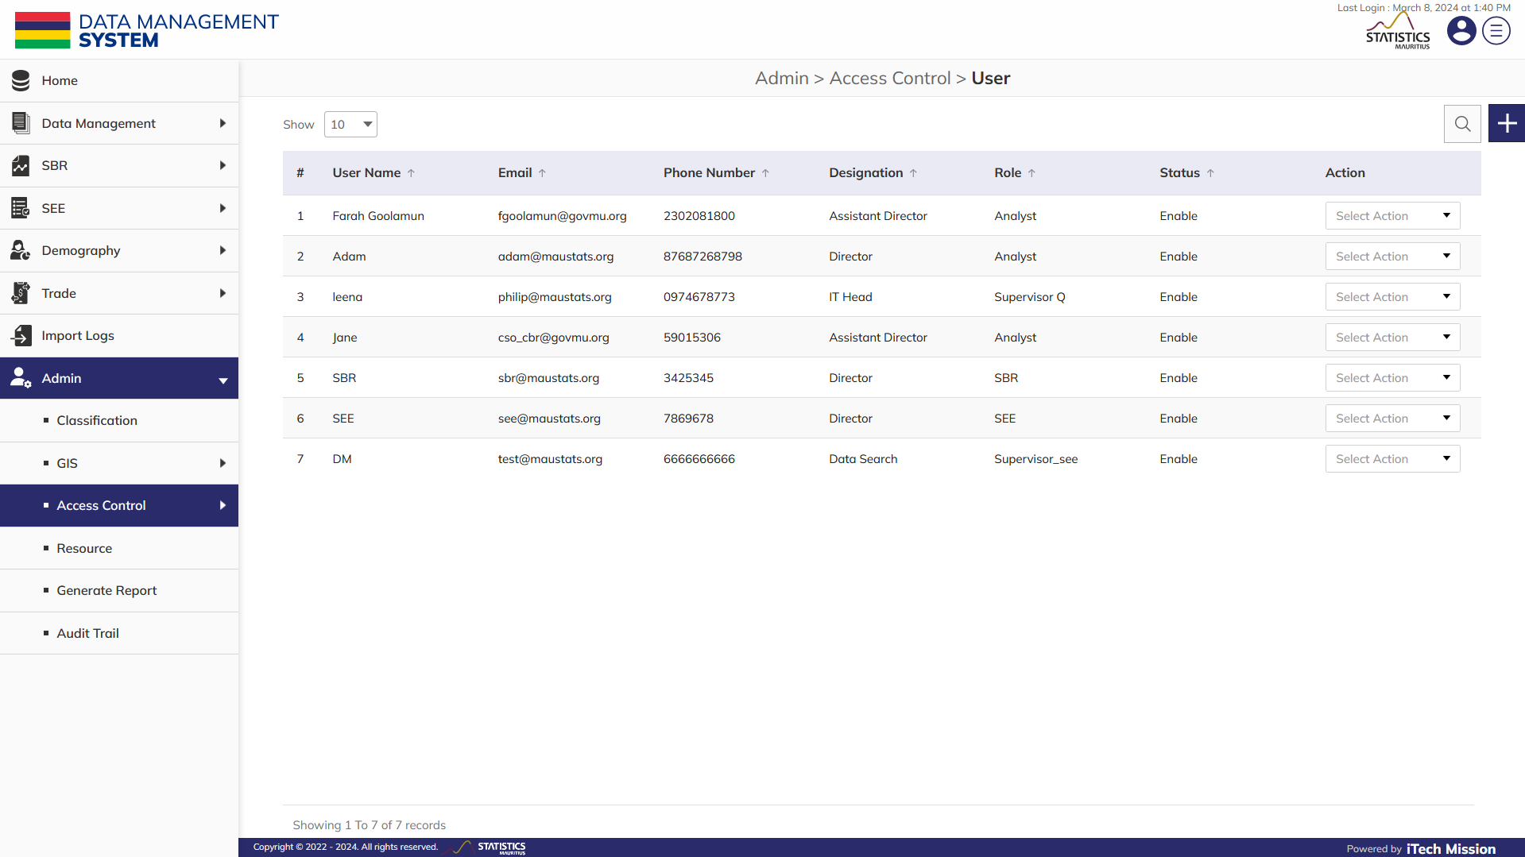
USER
Click on Plus button to add new user.

Slide 44
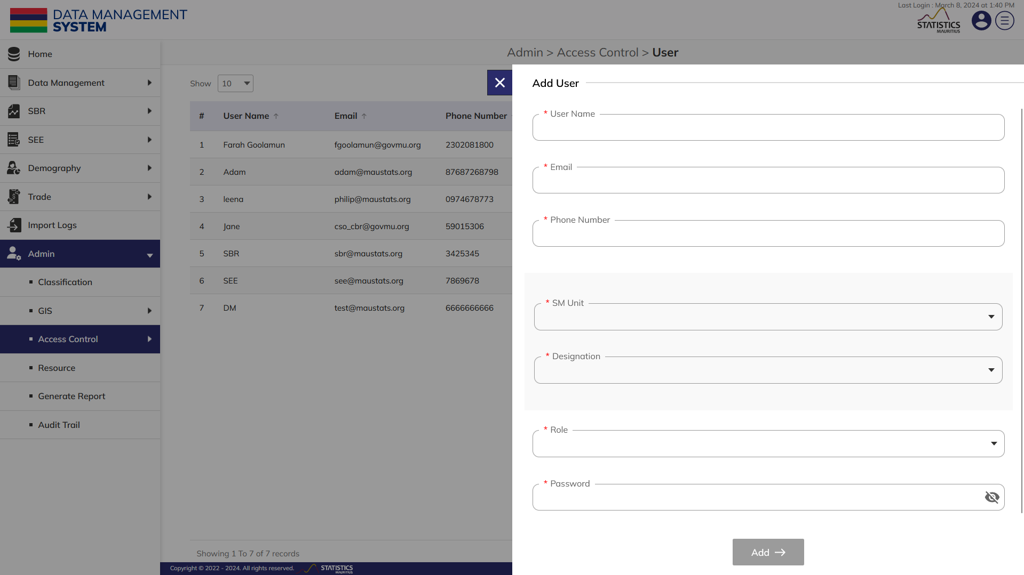
USER
Enter the User Name, Email, and Phone number and select SM unit, Designation, Role and set user Password (Mandatory fields to be filled).

Slide 45
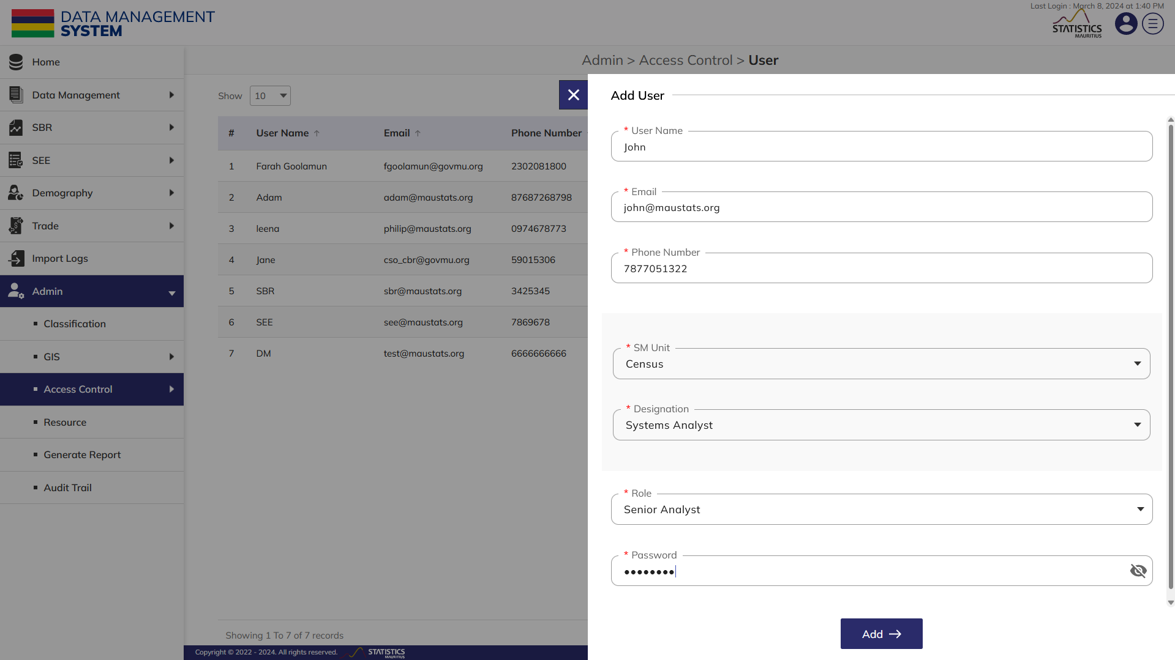
USER
Click on the Add button to save the user.

Slide 46
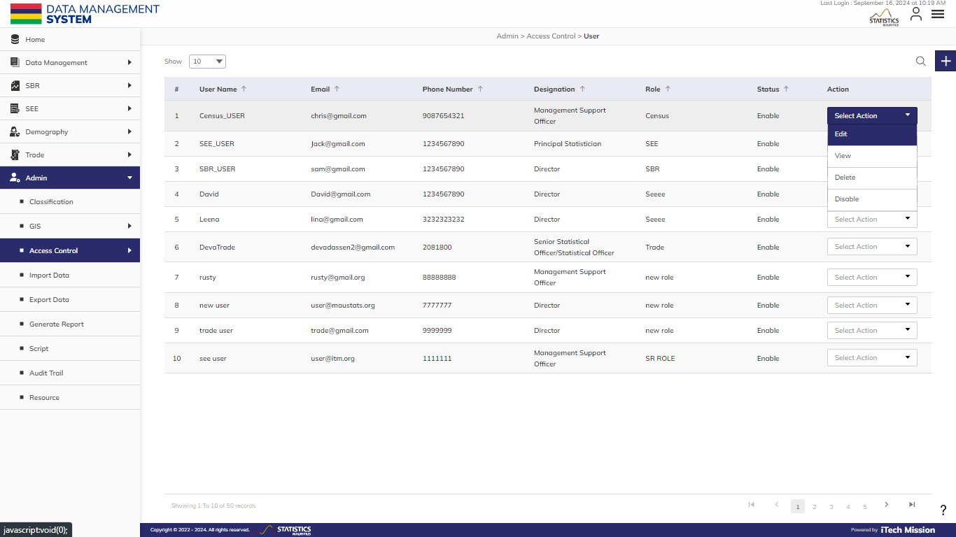
USER
Click on the action dropdown to Edit, View, Enable/Disable and Delete selected user.

Slide 47
4
IMPORT

Slide 48
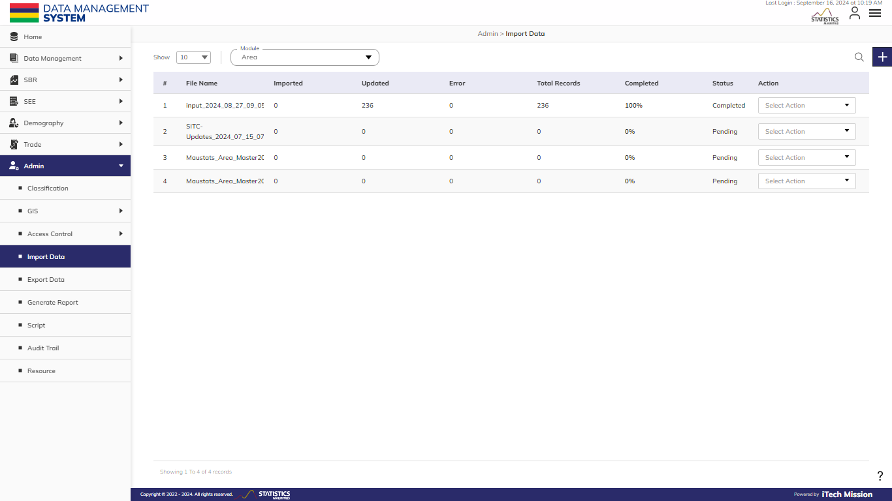
IMPORT
To Import data in Modules, select Admin – Import Data.

Slide 49
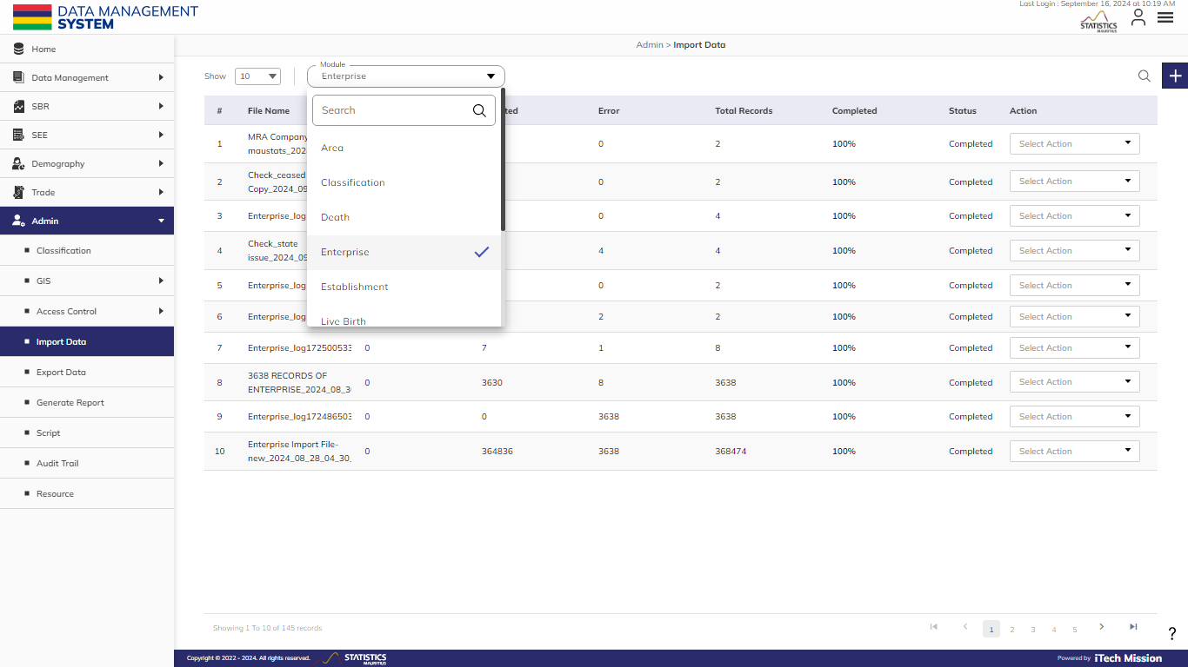
IMPORT
Select the Module from the dropdown menu.

Slide 50
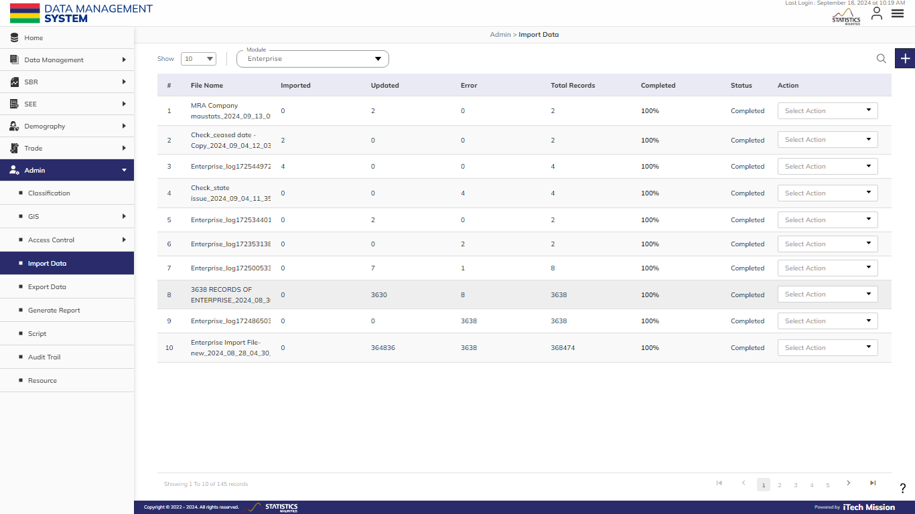
IMPORT
Click on the Plus button to import.

Slide 51
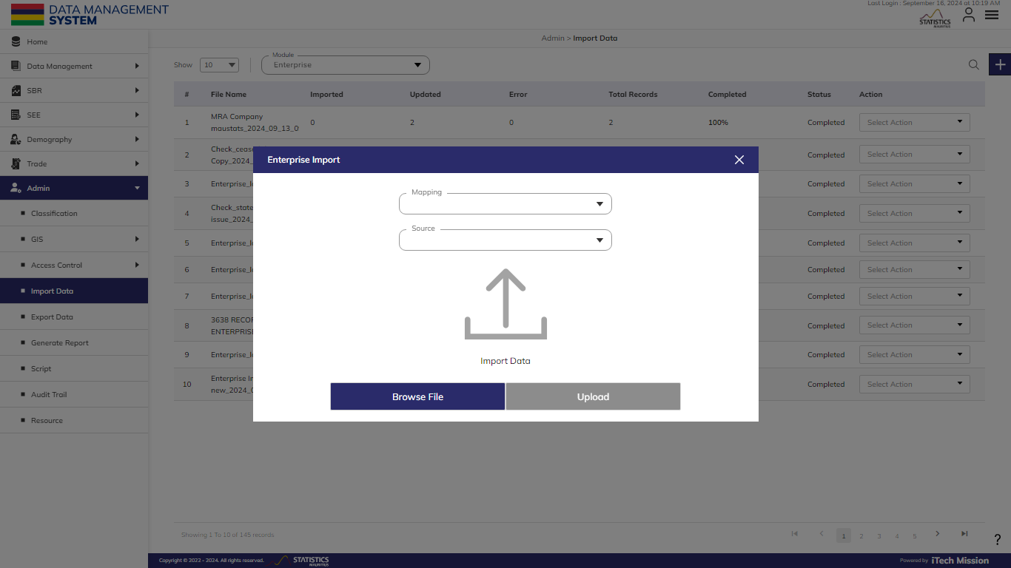
IMPORT
Select the Mapping, Source of Data, and Browse the file.

Slide 52
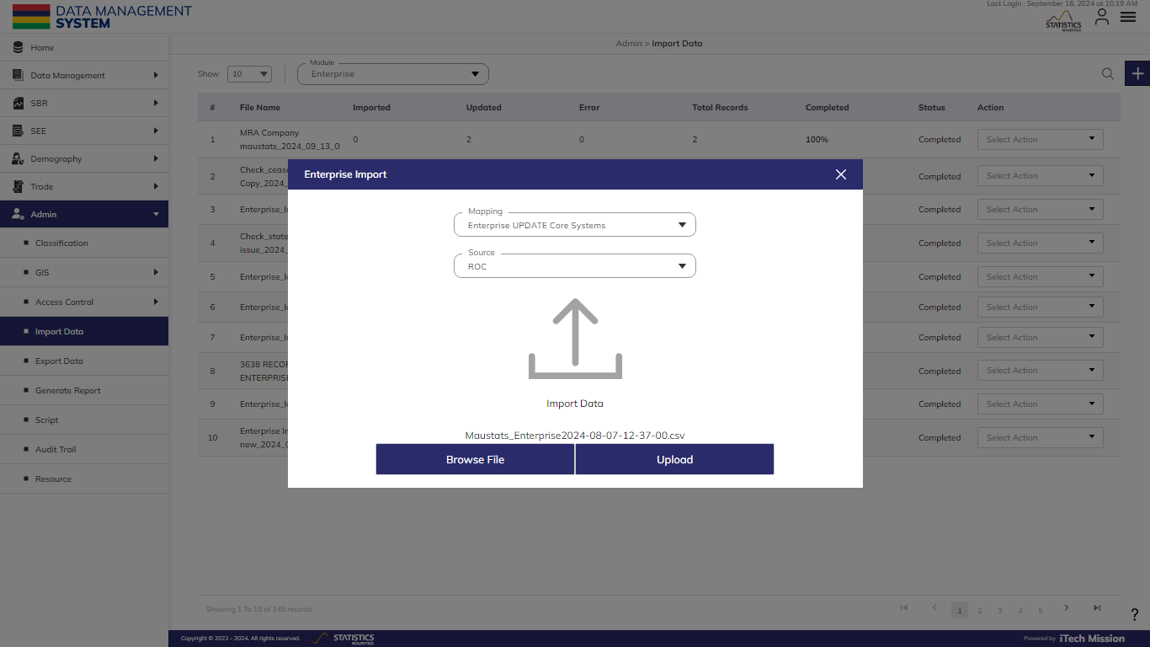
IMPORT
Click Upload to start importing data.

Slide 53
4
EXPORT

Slide 54
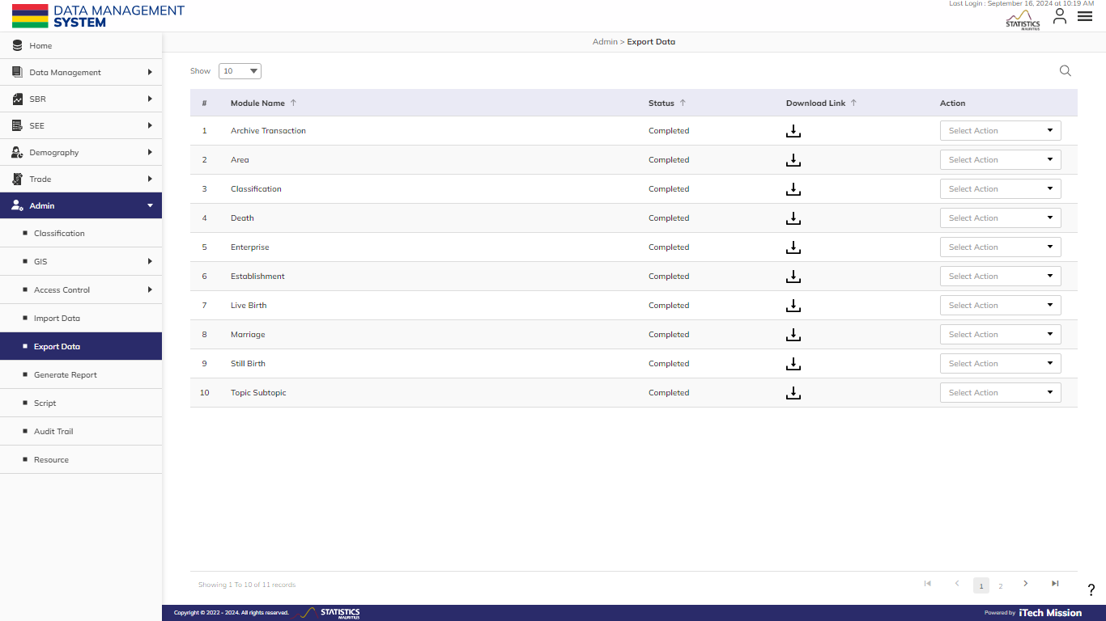
EXPORT
To Export data in Modules, select Admin – Export Data.

Slide 55
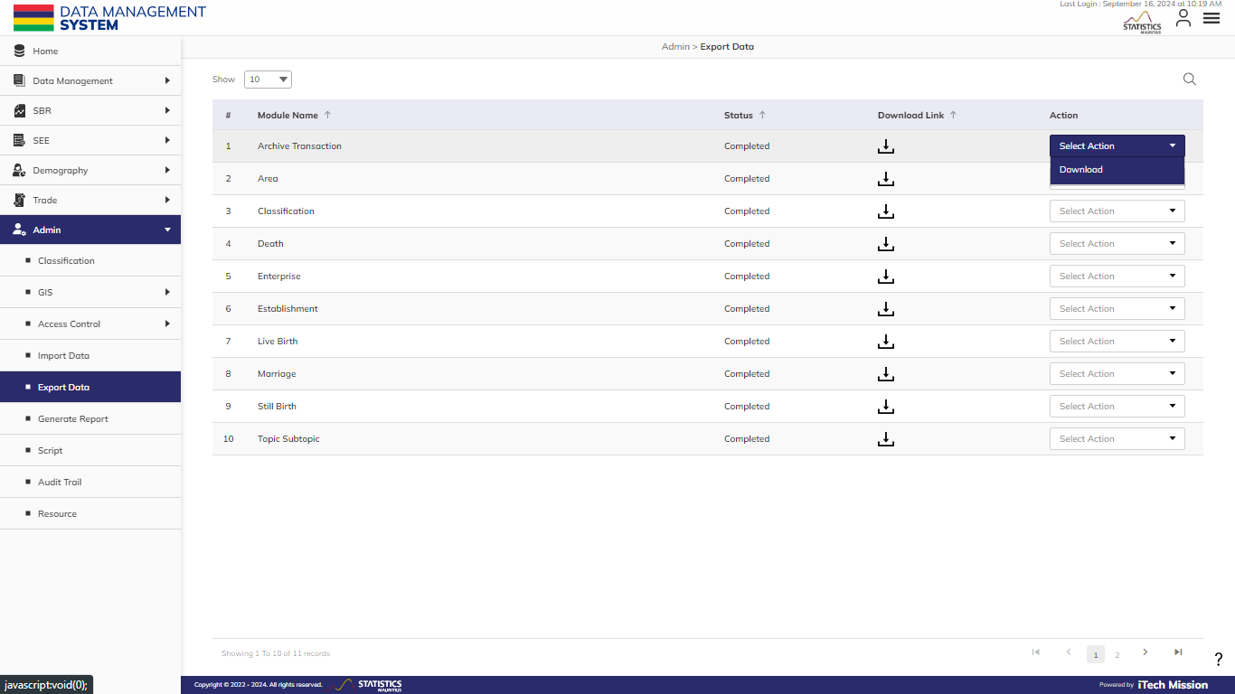
EXPORT
Click on the Action dropdown and Select Download

Slide 56
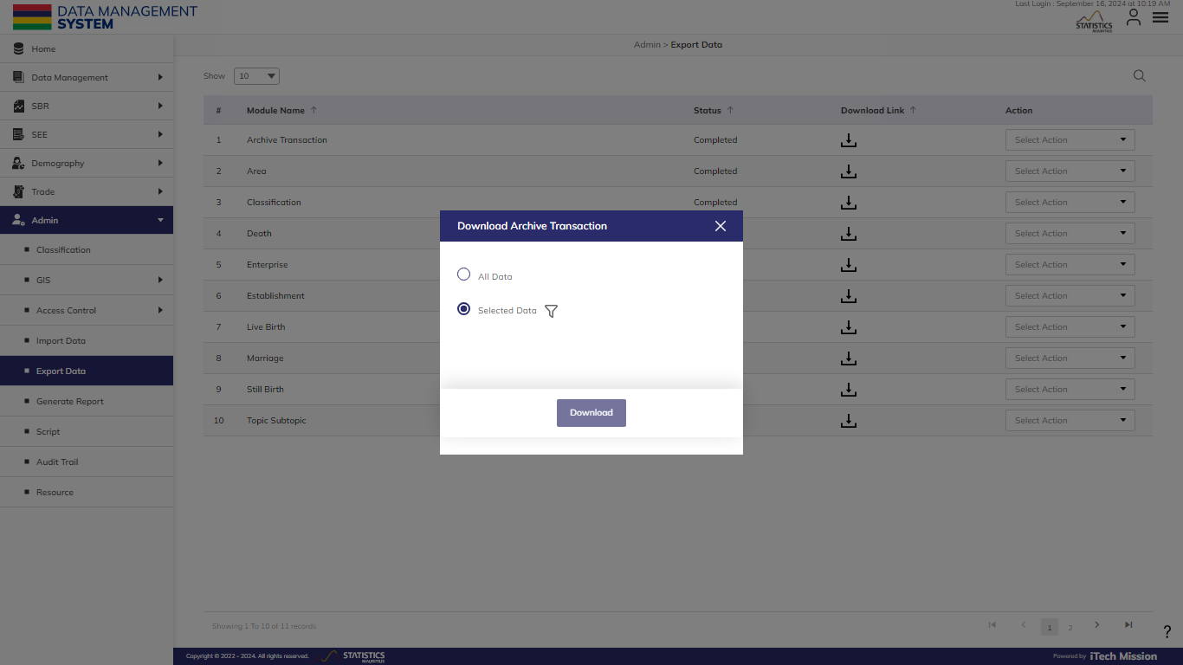
EXPORT
Select “All Data" to retrieve all the data available at that given point in time. Alternatively, for Selected Data utilize the "filter" function to specify the data to be downloaded.

Slide 57
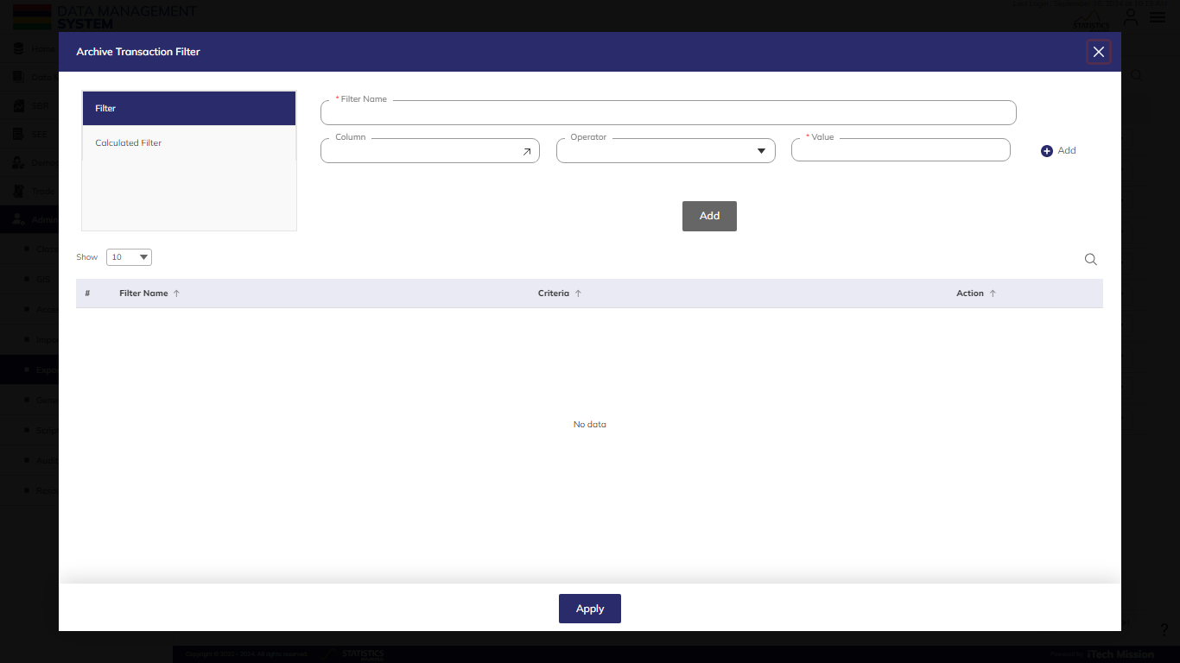
EXPORT
Add Filters and Click Apply.

Slide 58
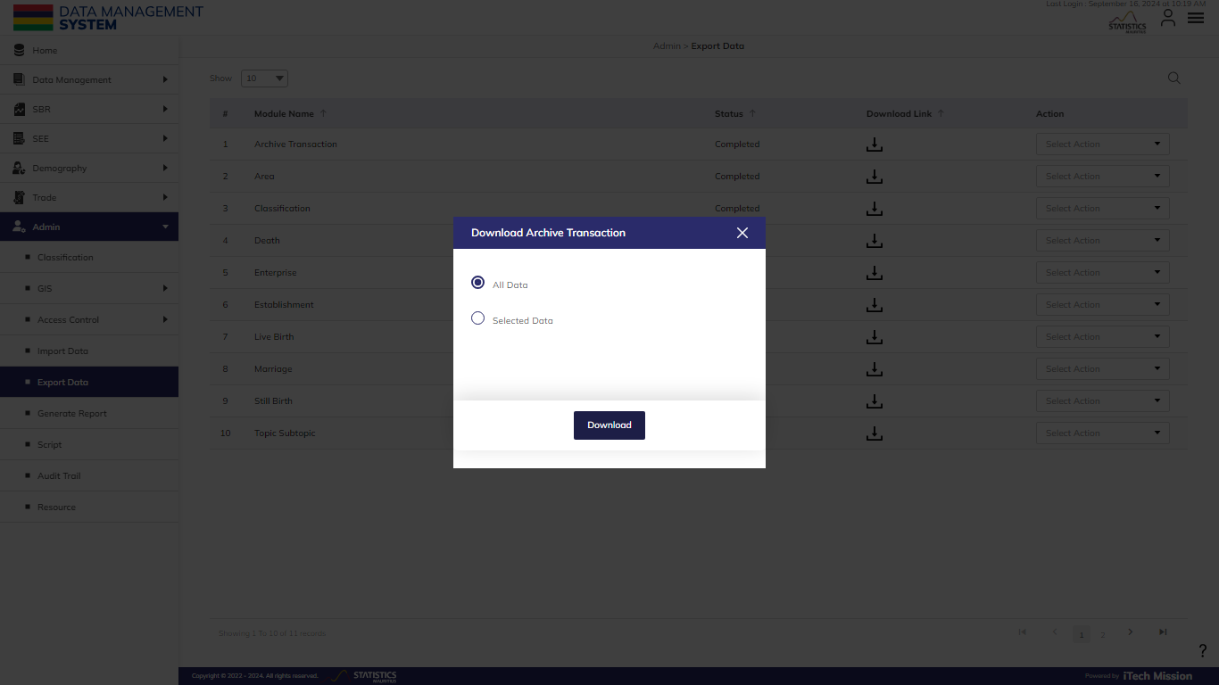
EXPORT
Click Download to initiate the generation of Download Link

Slide 59
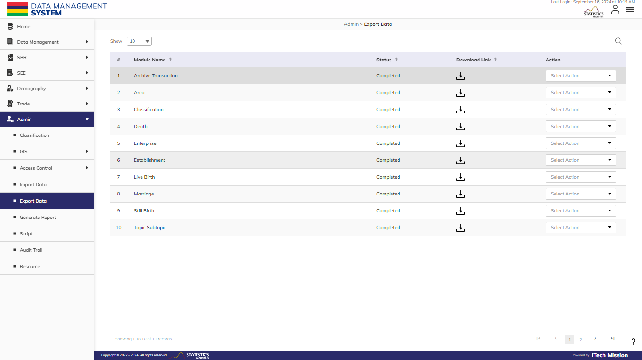
EXPORT
Click on the Download icon to initiate Downloading.

Slide 60
This section need to be first edited in the user guide and then updated here
5
GENERATE REPORT

Slide 61
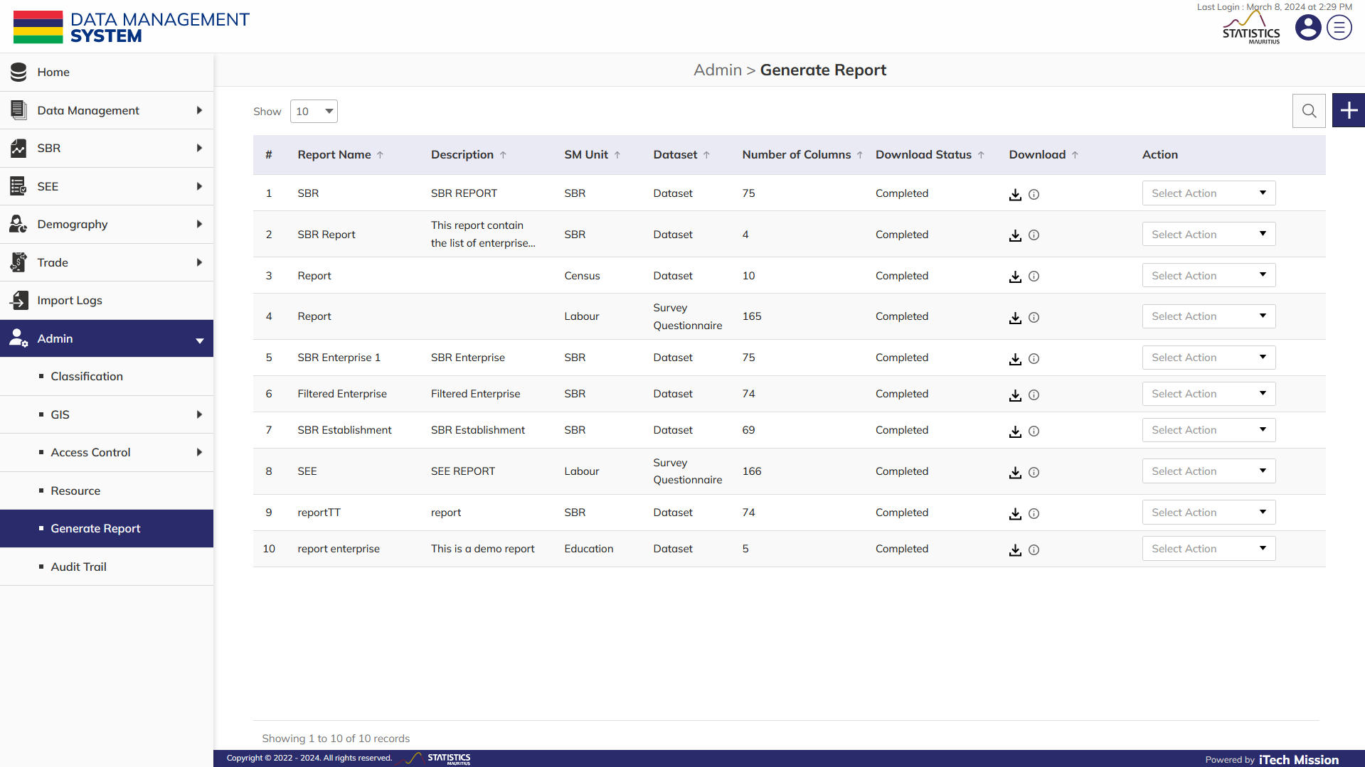
Generate Report
To generate and Manage the Report, select Admin – Generate Report.

Slide 62
Generate Report
Click on Plus button to generate a new Report.

Slide 63
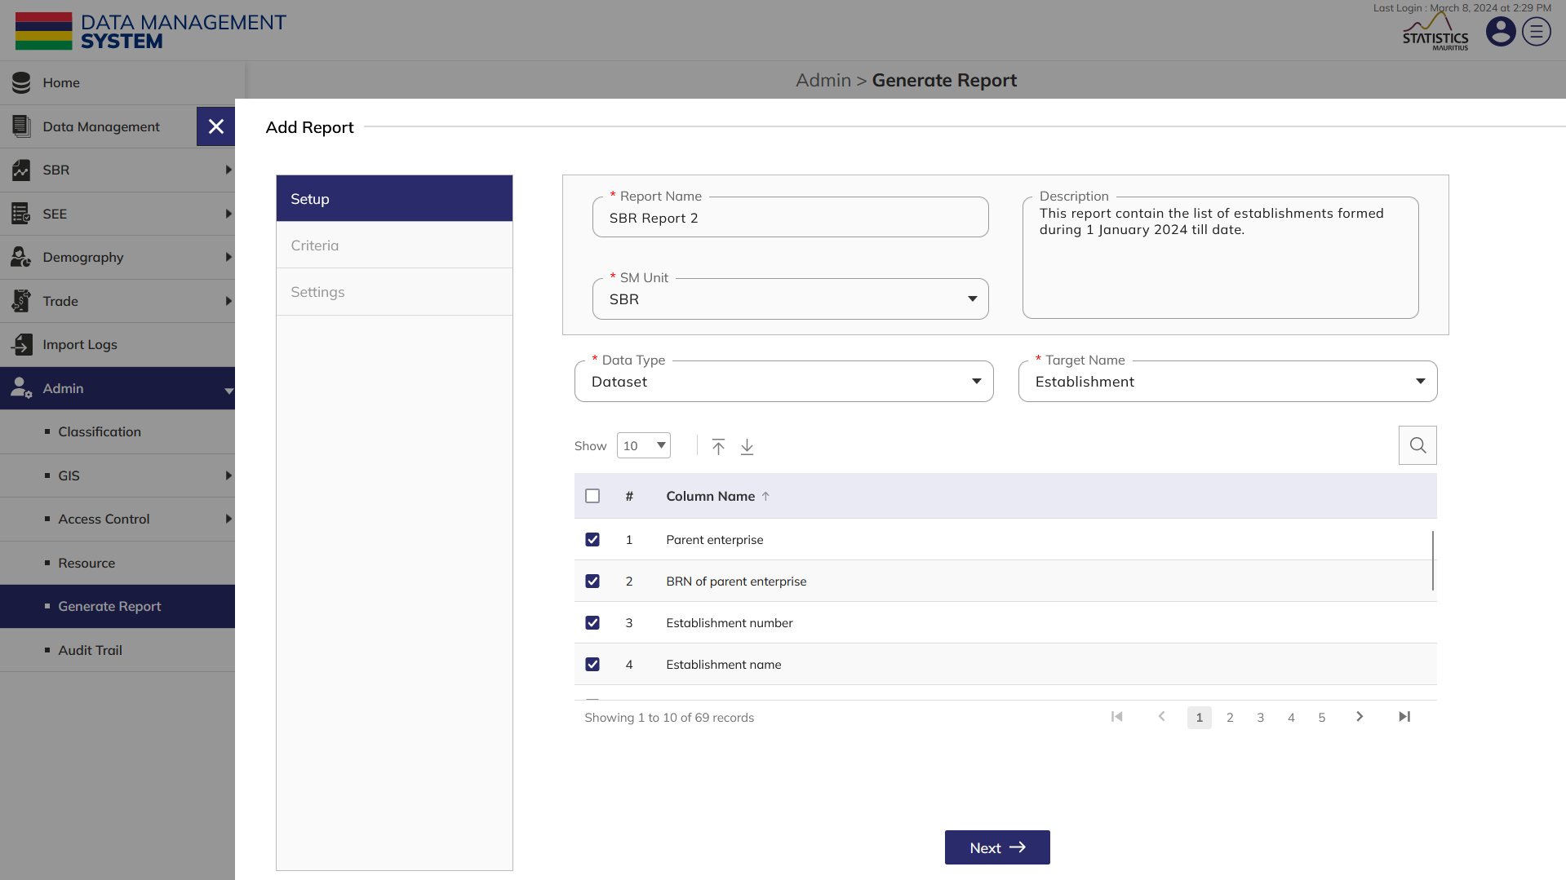
Generate Report
Enter Report Name and Description. Select SM Unit, Datatype, Target Name from the dropdown menu. Select the Column names that are required in the report (Mandatory fields to be filled).

Slide 64
GENERATE REPORT
After adding all the information in Setup window, click on Next button to move to the next window.
.

Slide 65
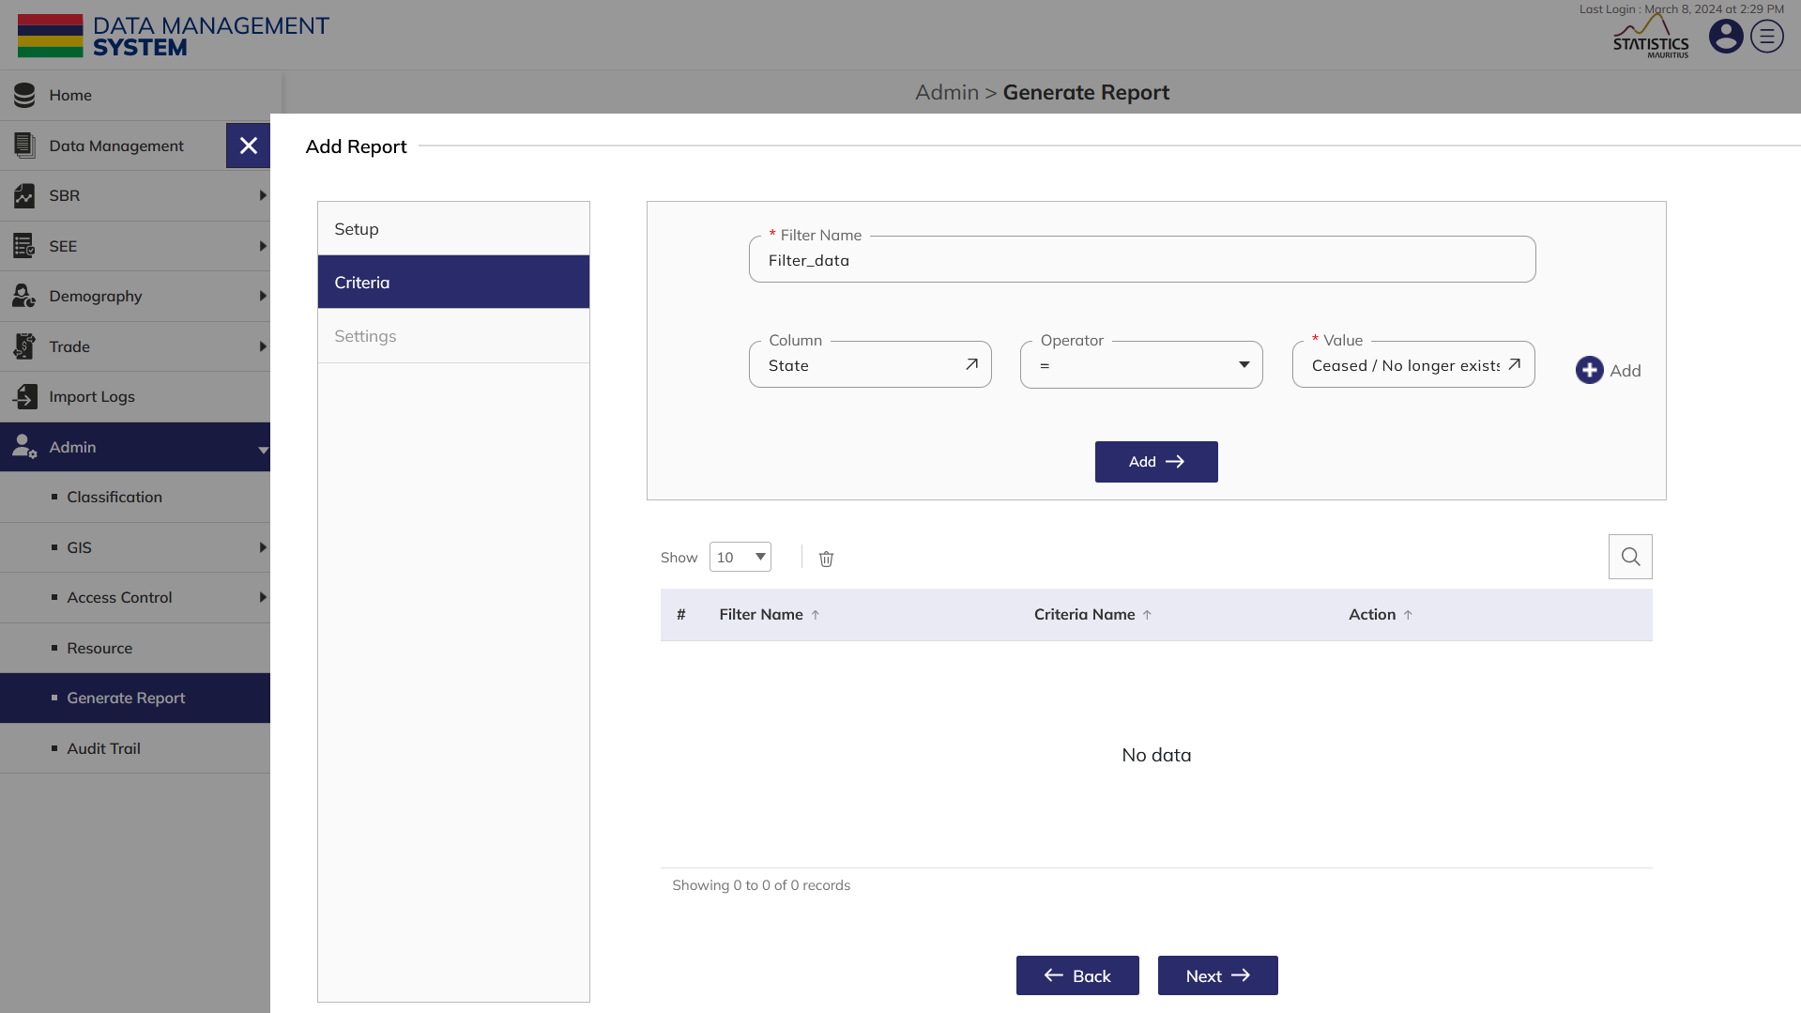
Generate Report
Enter Filter Name, select Column and Operator and enter Value .Click on Add to add the filter and get filtered data in report

Slide 66
Generate Report
.Click on Next to move to the settings window from criteria.

Slide 67
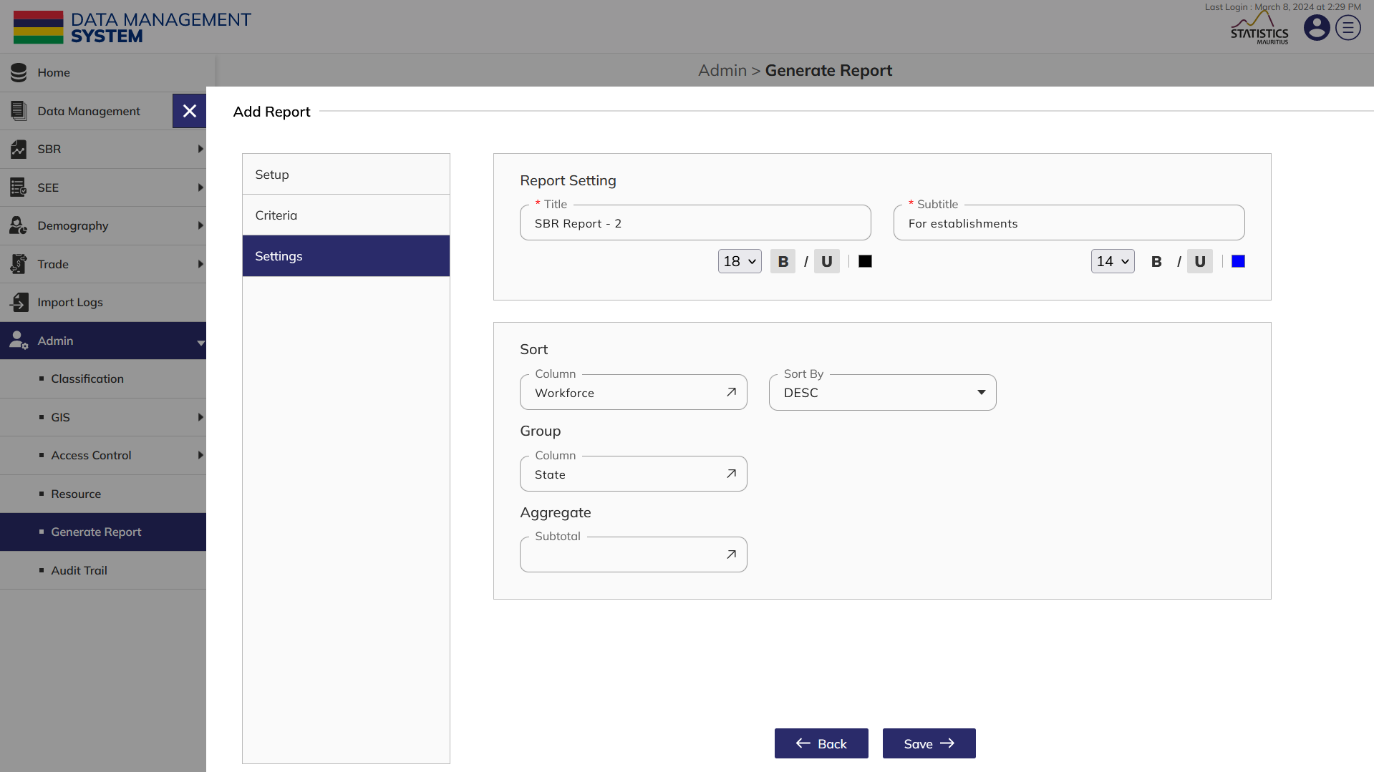
Generate Report
Give a Title and a Subtitle to the report. Edit the text by change the size, style and color of the font. Sort, Group or Aggregate the selected column if required. Click on Save button to generate a report.

Slide 68
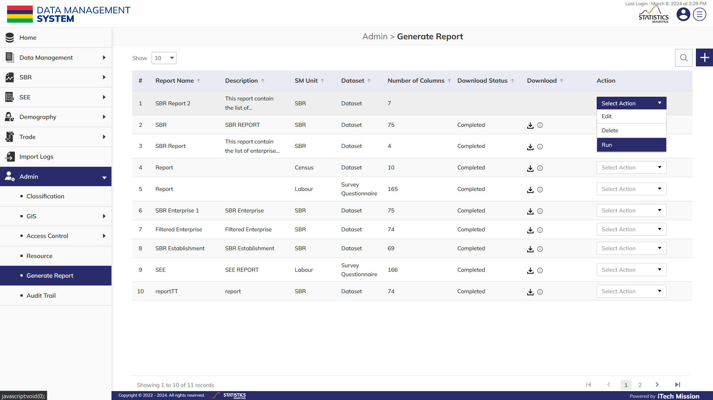
GENERATE REPORT
Click on the action dropdown menu to Edit, Delete and Run the entry. Click on Run to generate download link of the report.
.

Slide 69
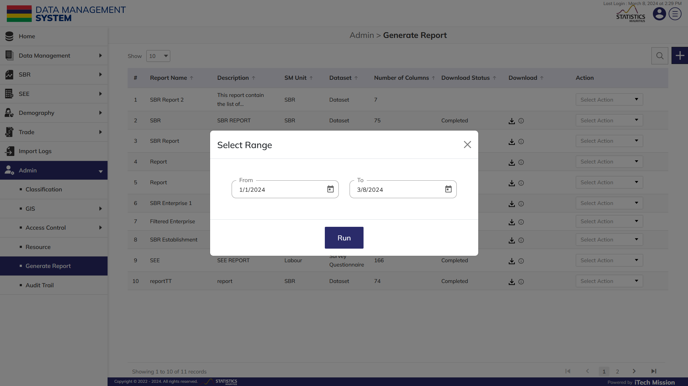
Generate Report
Select the Date Range for generating report data

Slide 70

Generate Report
.Click on the Download button to get the report in csv form.

Slide 71
4
SCRIPT

Slide 72

SCRIPT
To manage the Script master list, select Admin – Script.

Slide 73

SCRIPT
Select the Script Type from the dropdown menu.

Slide 74
SCRIPT
Click on the Plus button and add a new Script.

Slide 75

SCRIPT
Select the SM Unit, Script Type. Enter the Report Name and Description. Browse the file of type Zip (Mandatory fields to be filled).

Slide 76

SCRIPT
Click on the Add button to save the Script.

Slide 77

SCRIPT
Click on the dropdown to Edit, View, and Delete selected user.

Slide 78
6
Audit Trail

Slide 79

AUDIT TRAIL
To view user activities and changes, select Admin – Audit Trail.

Slide 80
AUDIT TRAIL
View existing audit logs. Click on Eye button and view audit history.

Slide 81

AUDIT TRAIL
Audit history of changes made in user status.

Slide 82
4
RESOURCE

Slide 83

RESOURCE
To manage the Resource master list, select Admin – Resource.

Slide 84
RESOURCE
Click on the Plus button and add a new Resource.

Slide 85

RESOURCE
Enter the Resource Name, Resource Description, and Resource Type, Insert URL and Category, and Browse Image file. (Mandatory fields to be filled)

Slide 86

RESOURCE
If the Resource type is Document, browse and upload the resource file.

Slide 87

RESOURCE
Click on Add button to save the resource.

Slide 88

RESOURCE
Click on the dropdown to Edit, View, Enable/Disable and Delete selected Resources.

Slide 89


